Slide 1
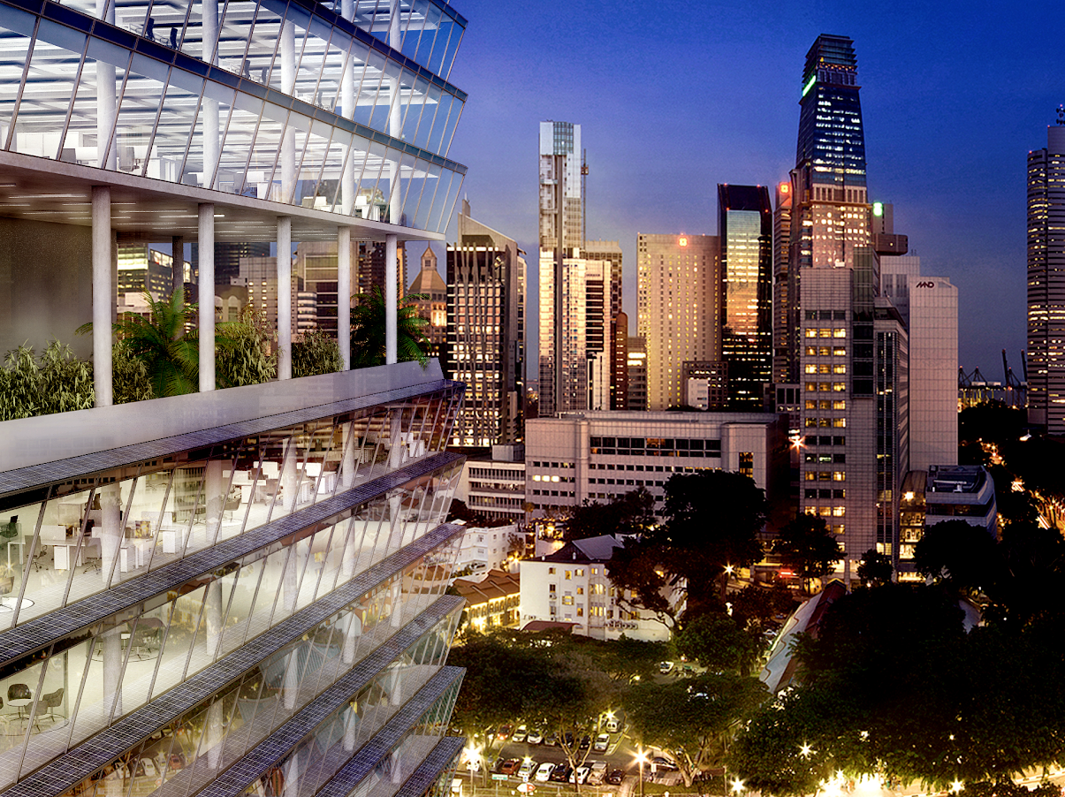
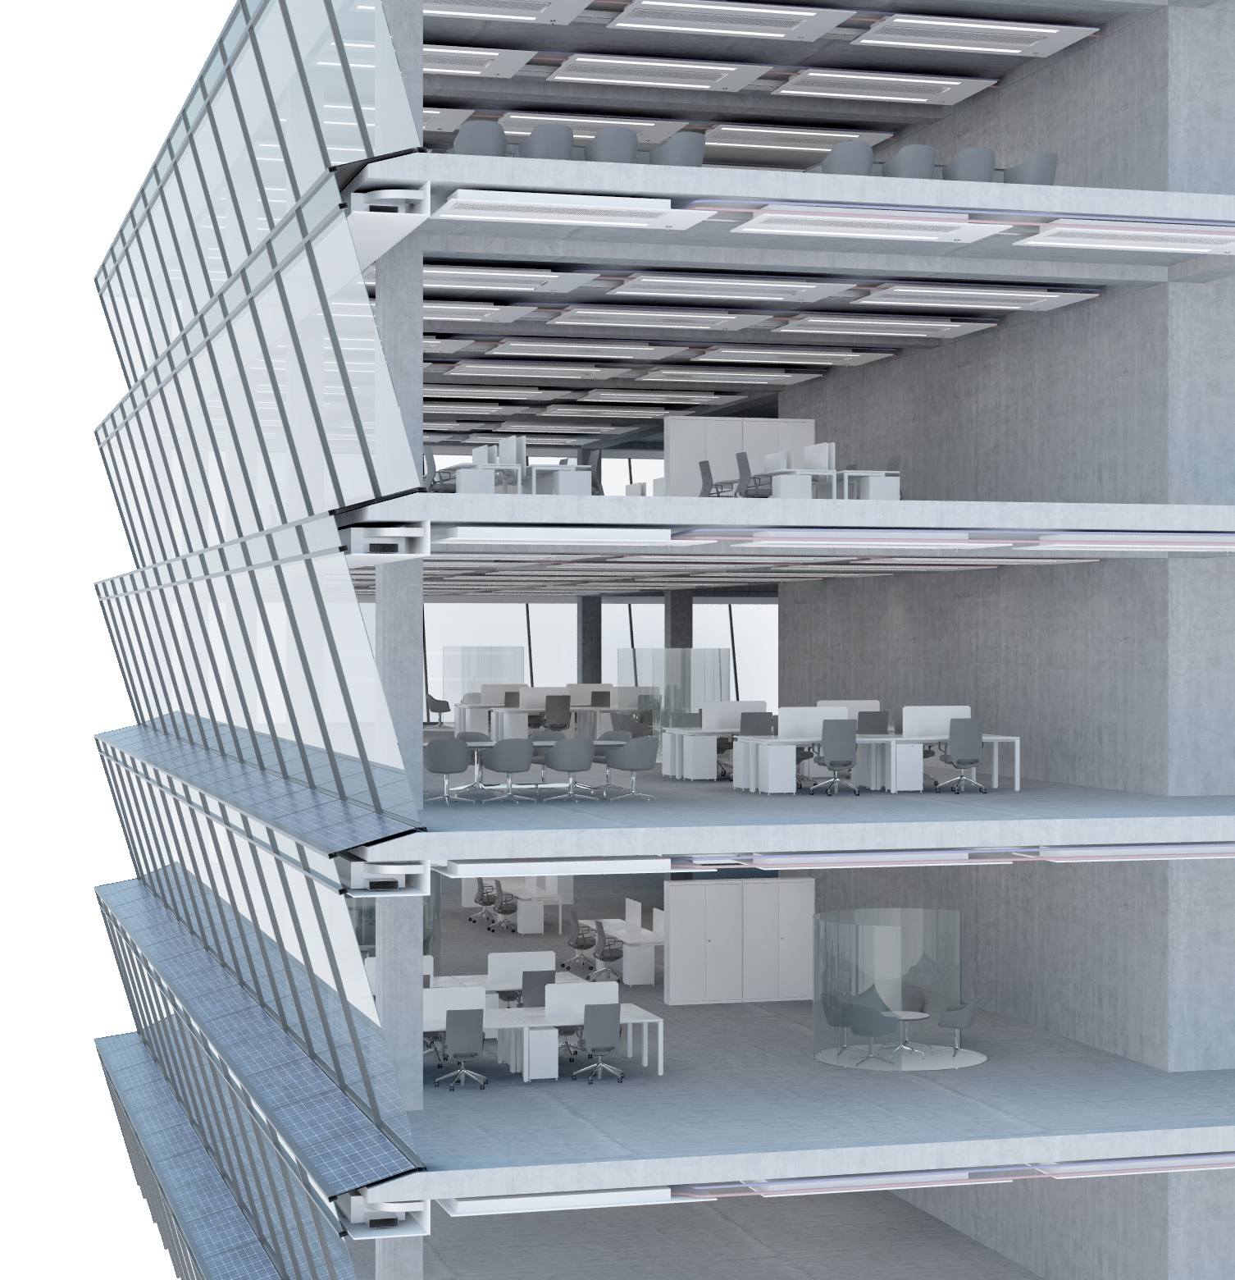
Architectural Design for 3for2 Solar Facade
Master in Integrated Building Systems
Semester project
HS 2018
Student: Natasha Catunda
Supervisor: Dr. Johannes Hofer
Examiner: Prof. Dr. Arno Schlüter
Images credits: Arno Schlueter and Adam Rysanek. 3for2 beyond efficiency presentation, 2016.

Slide 2

Goal
Assess the impact of electrical production and cooling loads on total energy consumption of different options for 3for2 facade

Slide 3


How
Parametric
model
Sun path
Radiation analysis

Slide 4
Presentation outline
3for2 concept
Sun path
Validation of solar results
Status quo analysis
Optimization studies
Electricity production
Cooling loads
Trade-off analysis
Conclusion and discussion

Slide 5
3for2 concept
3for2 concept
Sun path
Validation of solar results
Status quo analysis
Optimization studies
Electricity production
Cooling loads
Trade-off analysis
Conclusion and discussion

Slide 6
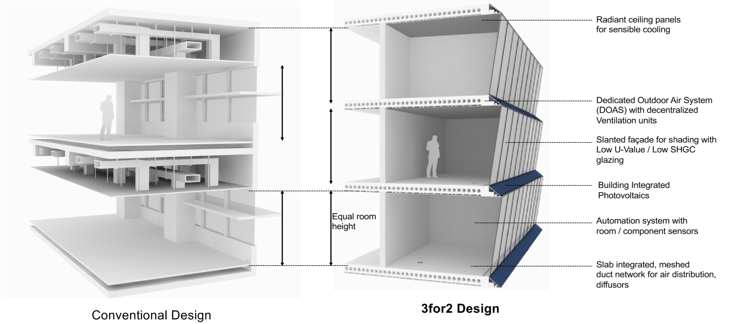
3for2 Concept
Source: Arno Schlueter and Adam Rysanek. 3for2 beyond efficiency presentation, 2016.

Slide 7
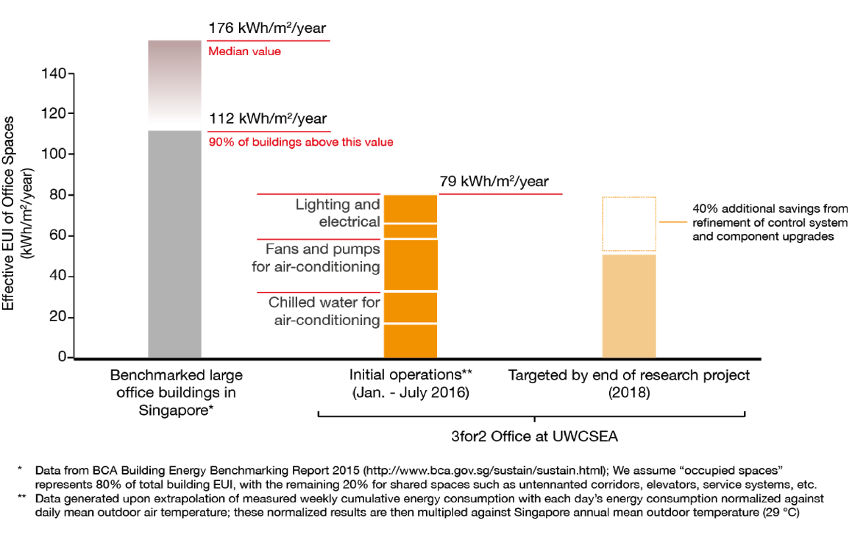
Benchmark
~47.4 kWh/m2.y
Solar facade will try to address the solar electricity production to reach total building electricity consumption expected for the end of research project in 2018 of 47.4 kWh/m²/year
Source: Arno Schlueter and Adam Rysanek. 3for2 beyond efficiency presentation, 2016.

Slide 8
Sun path
3for2 concept
Sun path
Validation of solar results
Status quo analysis
Optimization studies
Electricity production
Cooling loads
Trade-off analysis
Conclusion and discussion

Slide 9

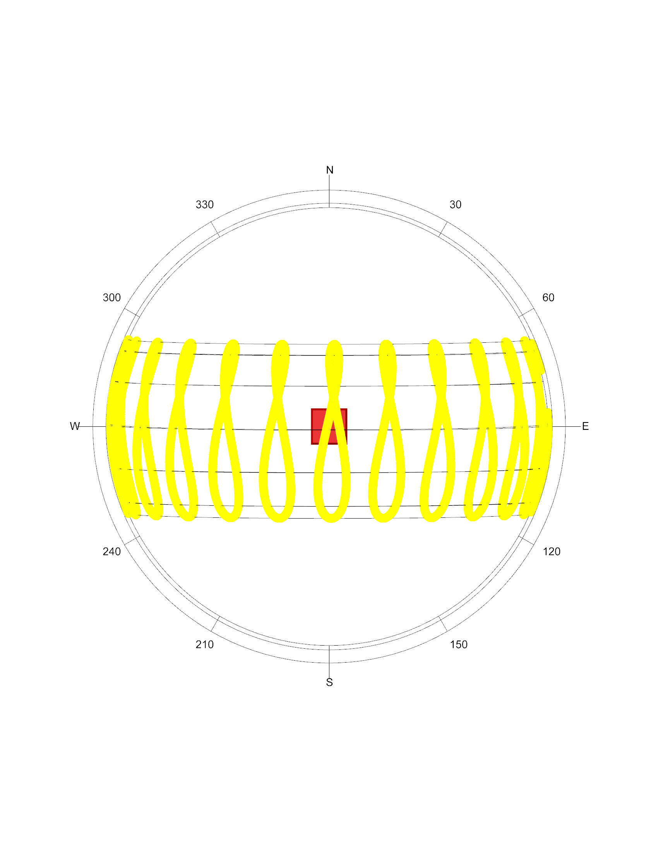
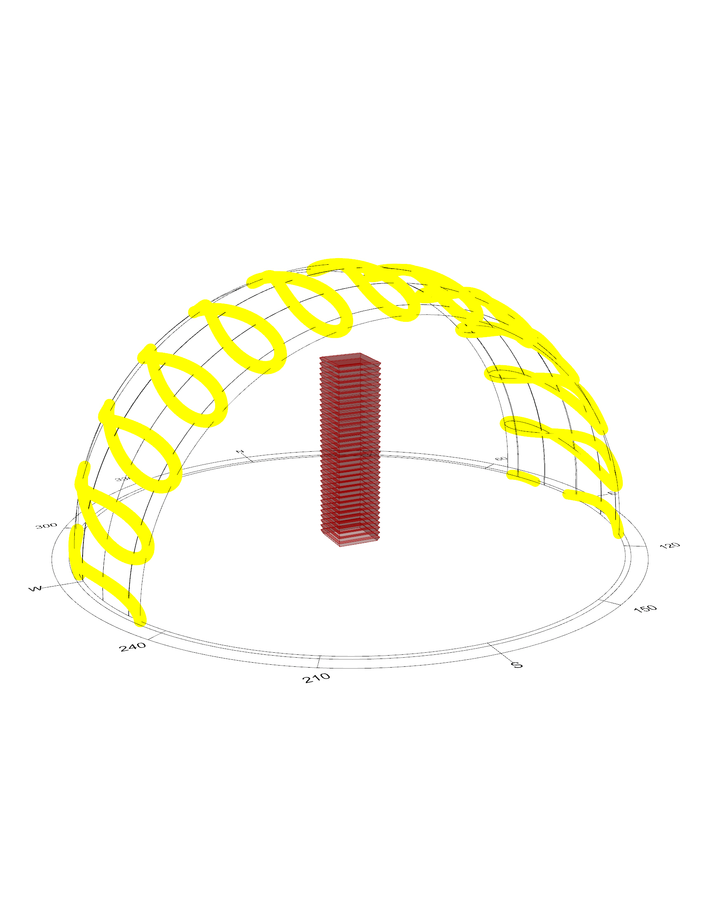
Sunpath
Singapore
1° 21' N, 103° 49' E

Slide 10
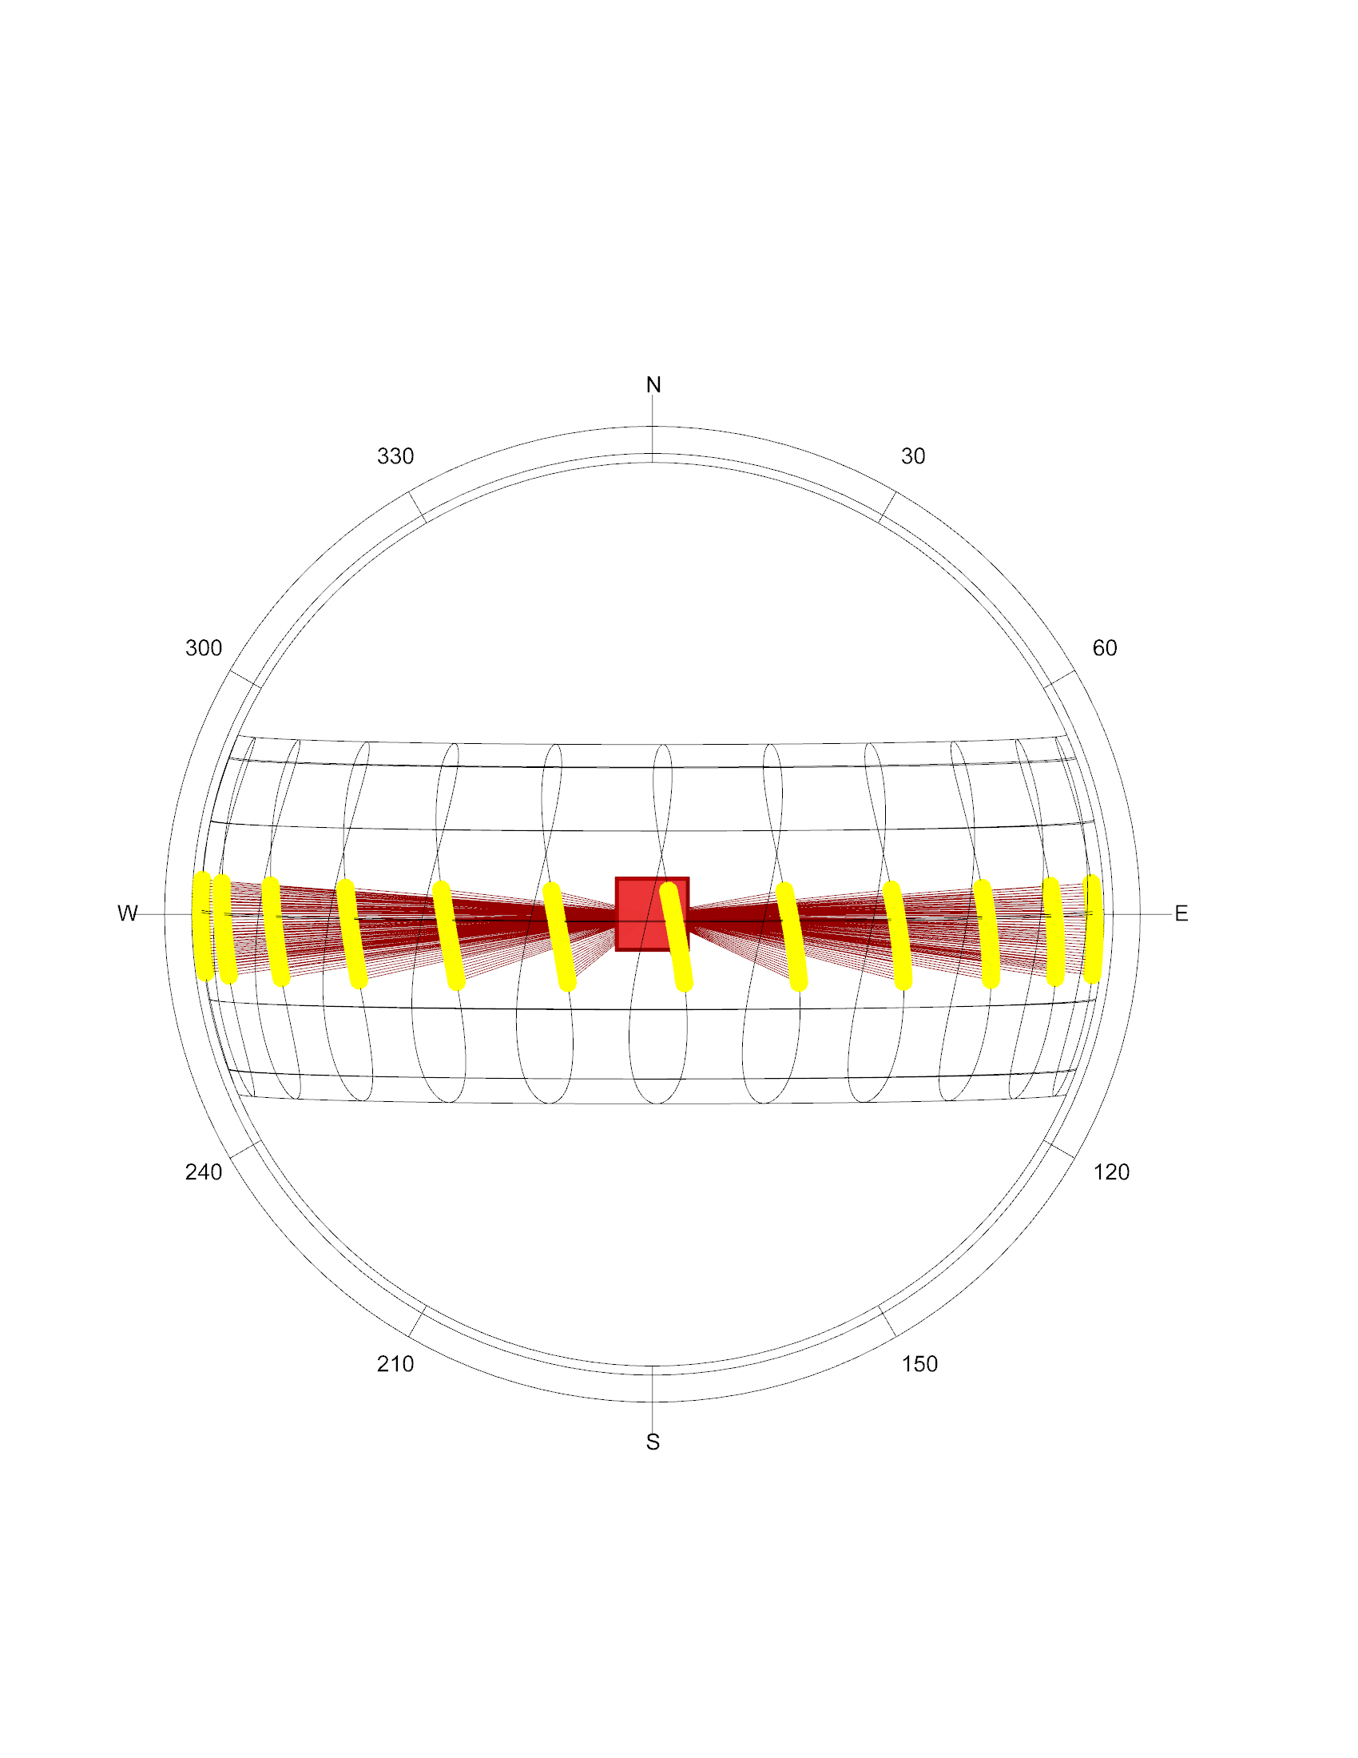
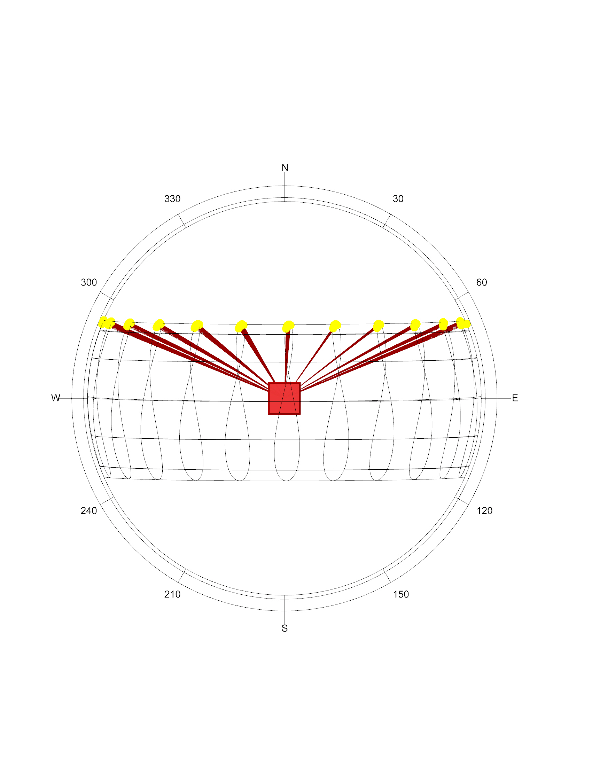
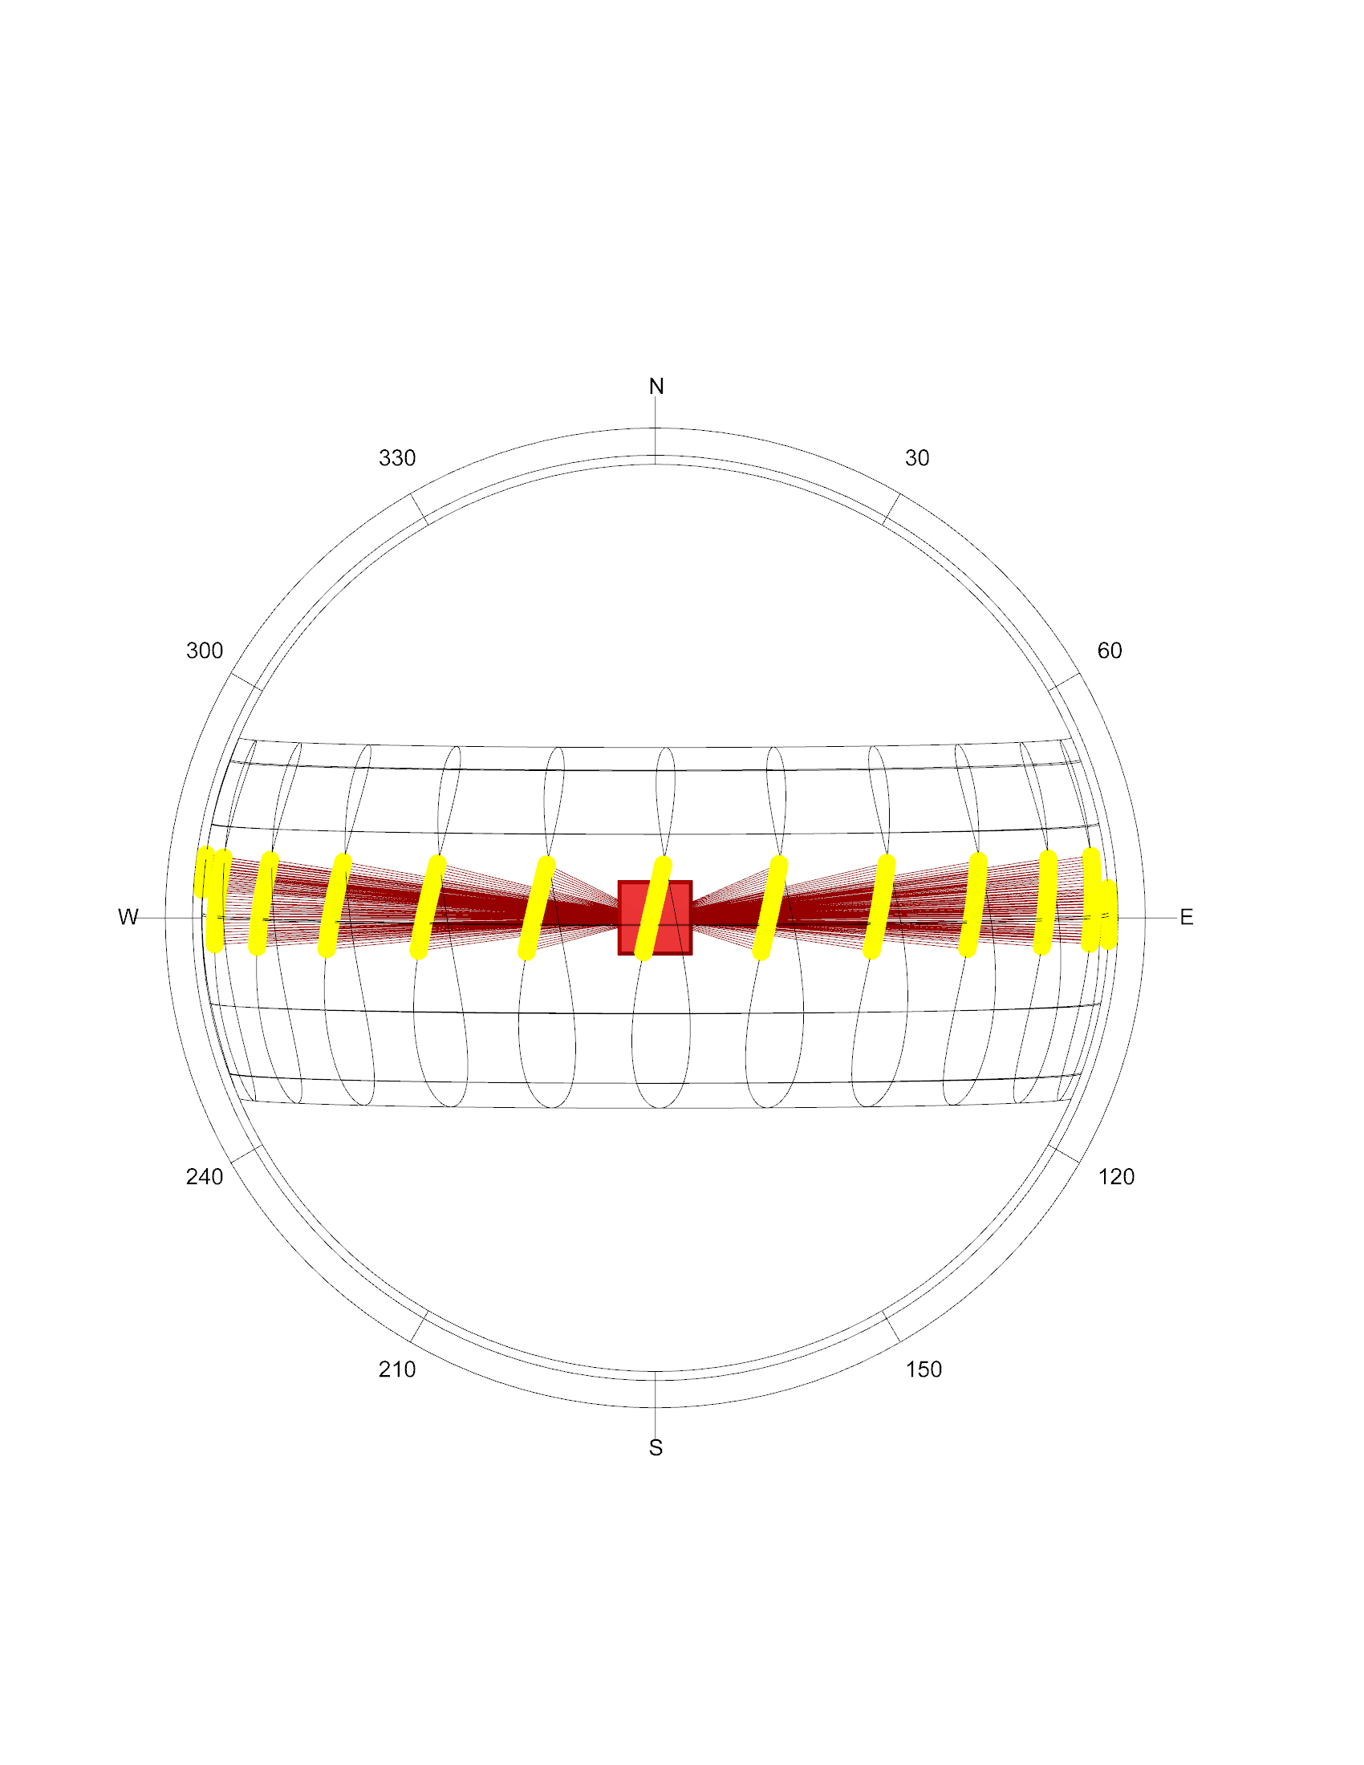
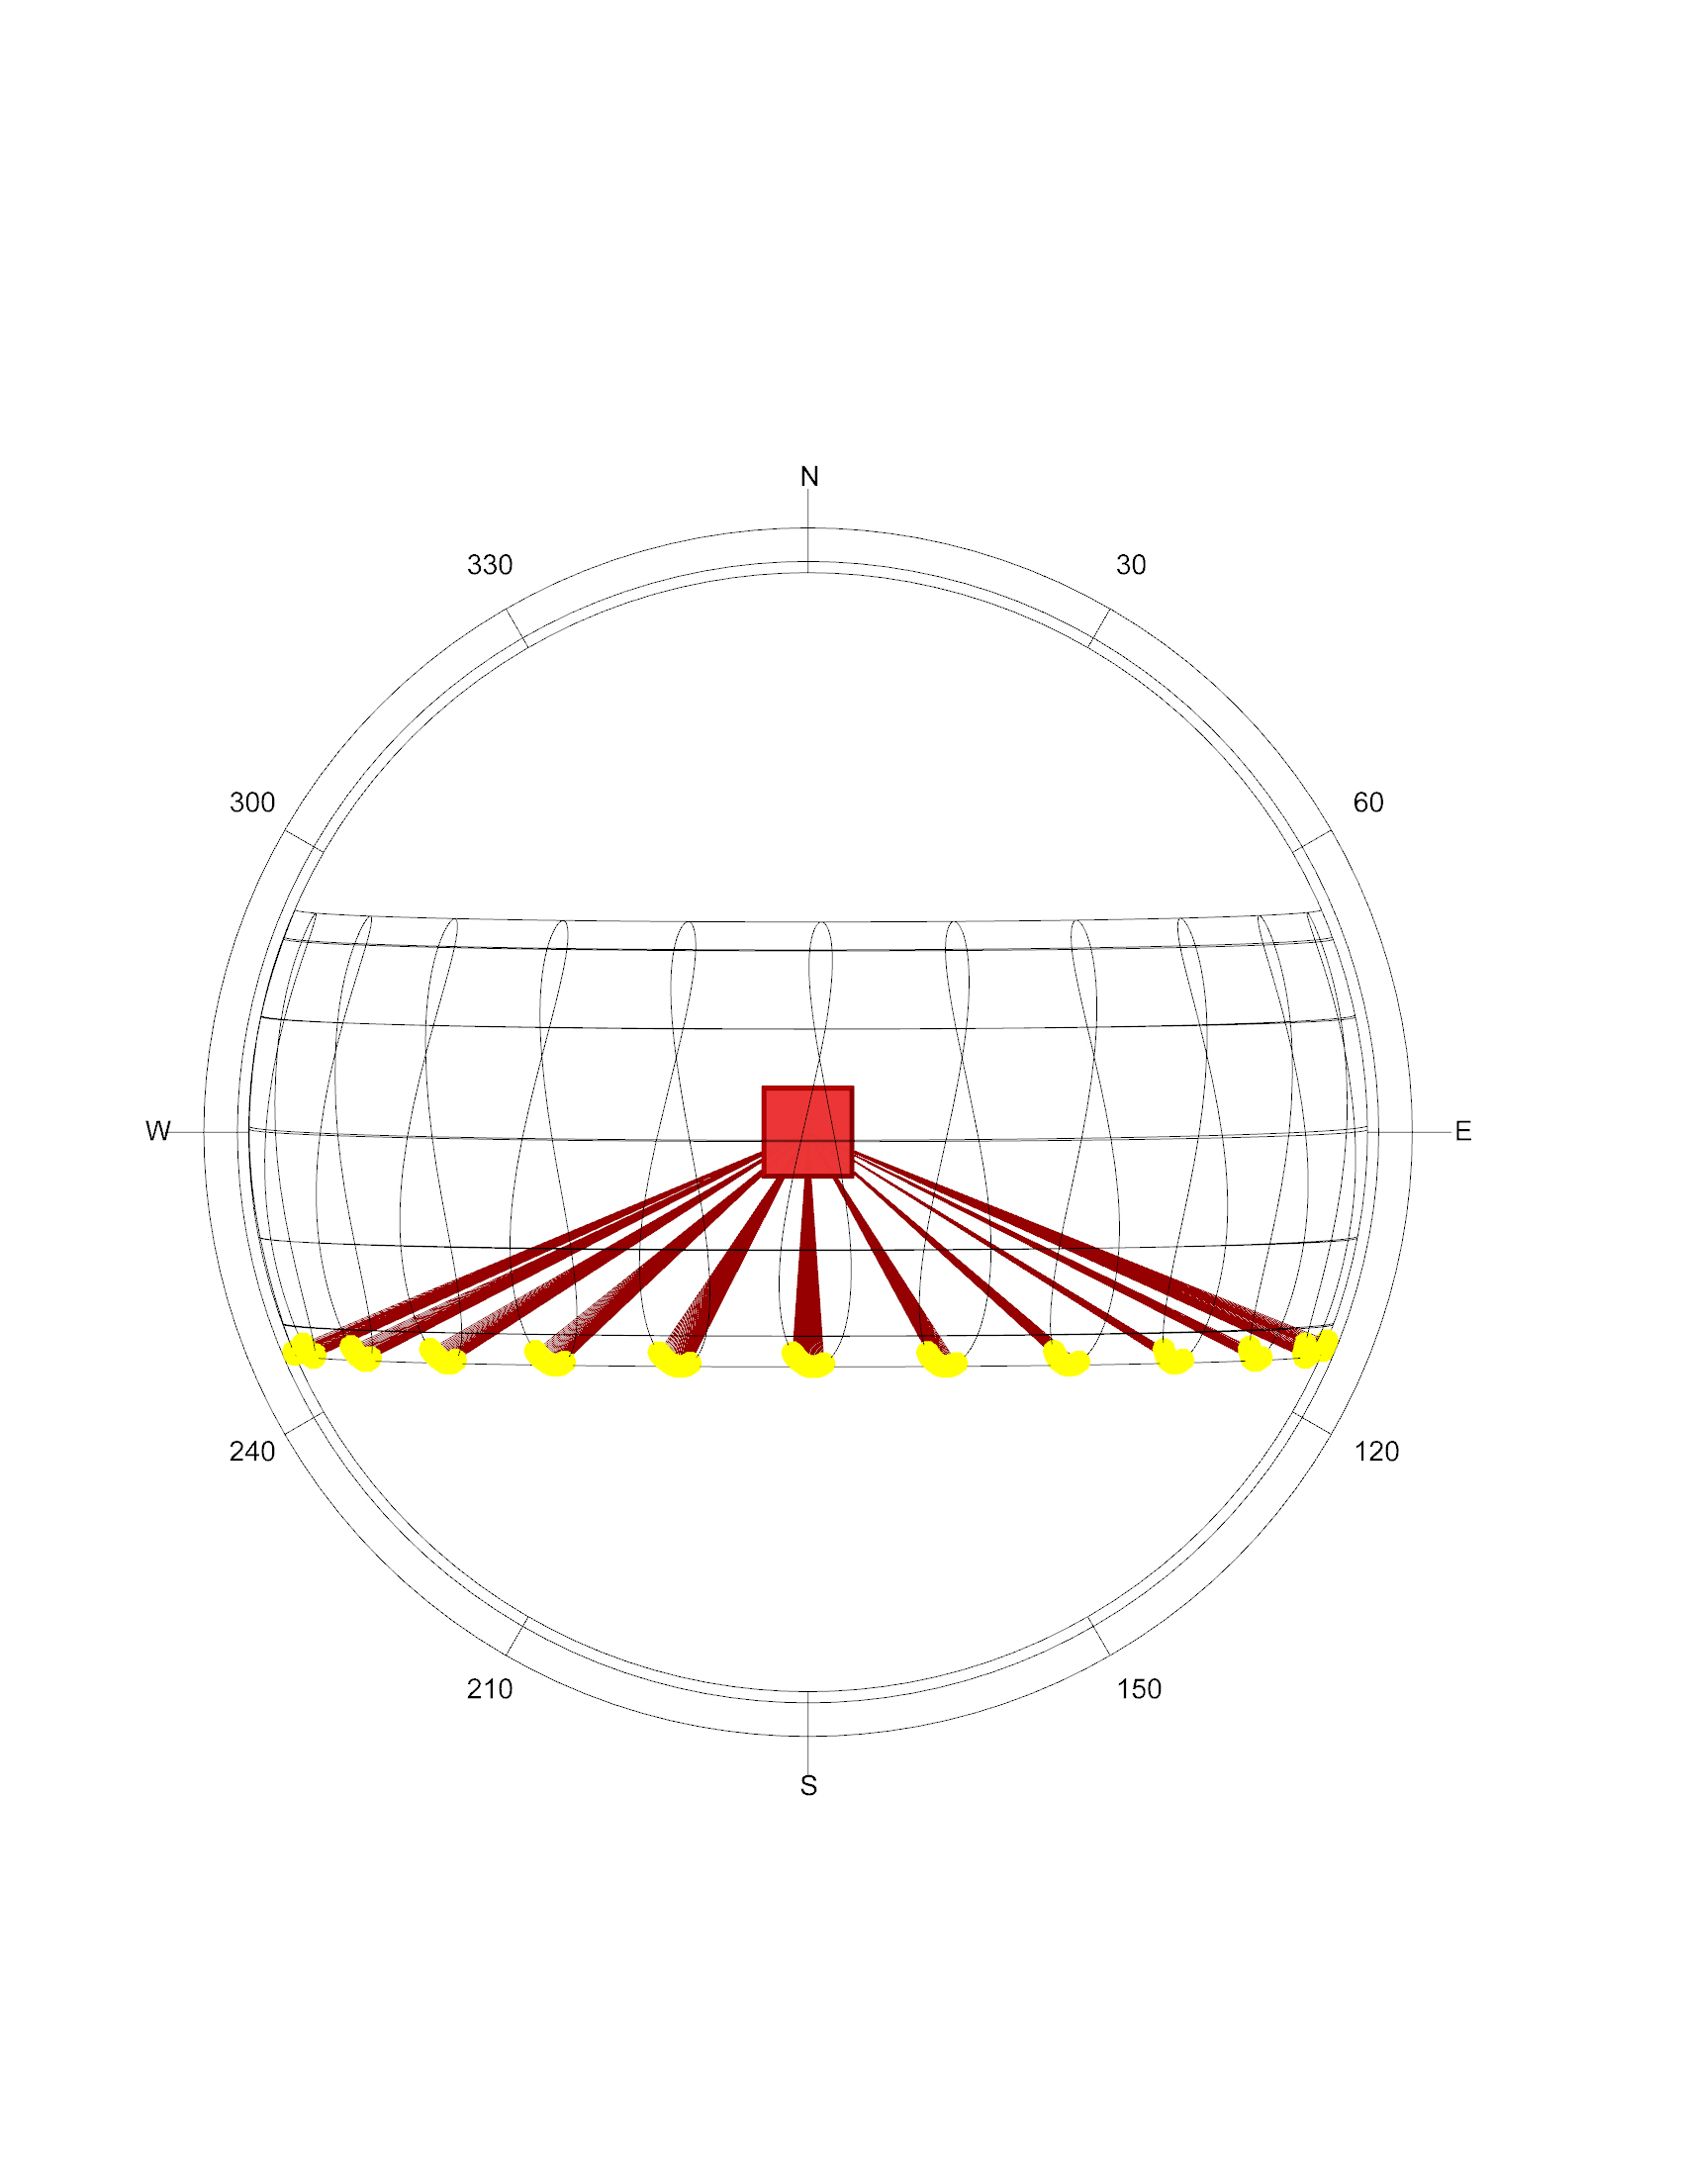
Sunpath
Singapore
1° 21' N, 103° 49' E
March
June
September
December

Slide 11
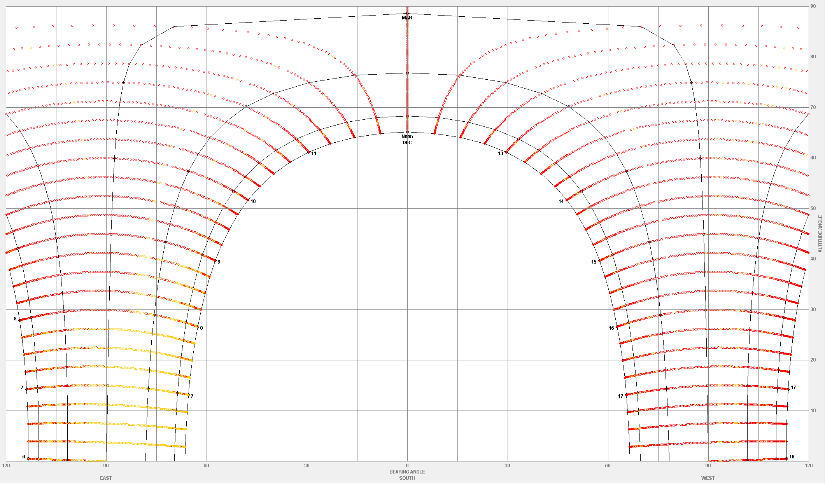
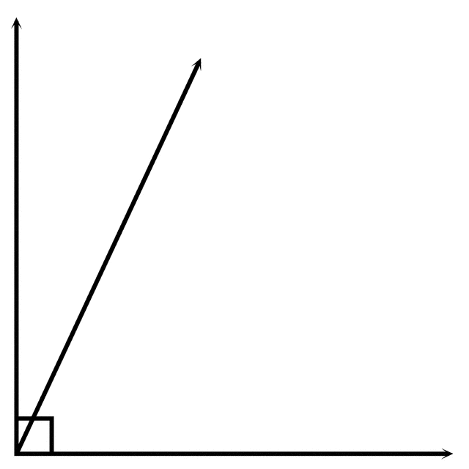
Sunpath | Minimal vertical angle
December
~ 65°
Singapore
1° 21' N, 103° 49' E
Source: Climate Consultant

Slide 12
Validation of solar results
3for2 concept
Sun path
Validation of solar results
Status quo analysis
Optimization studies
Electricity production
Cooling loads
Trade-off analysis
Conclusion and discussion

Slide 13

Solar radiation |PVGIS-Sarah x LB
Solar radiation |PVGIS-Sarah x LB
Δ 73 kWh/m2 (4%)
Data source: http://re.jrc.ec.europa.eu/pvg_tools/en/tools.html

Slide 14
Status quo analysis
3for2 concept
Sun path
Validation of solar results
Status quo analysis
Optimization studies
Electricity production
Cooling loads
Trade-off analysis
Conclusion and discussion

Slide 15

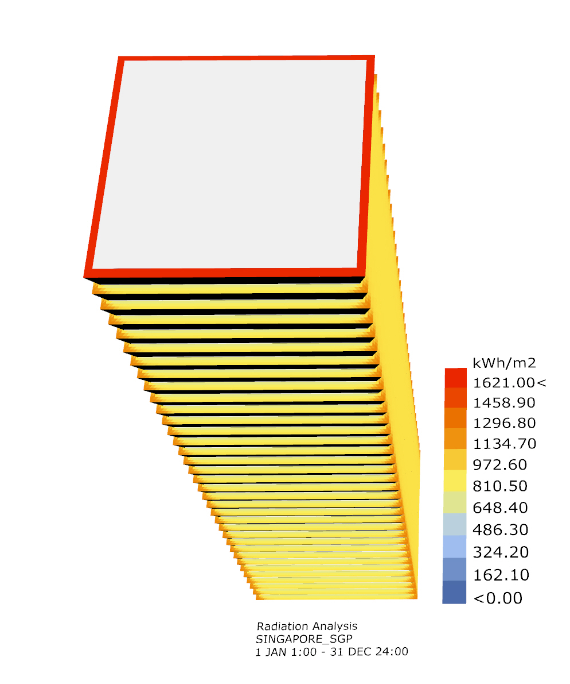
Total solar radiation | PV panels | year
Used Parameters
Amount of Floors | 35
Floor size | 30mx30m
Floor height | 3.65m
Total floor area | 31’500m2
PV dimensions:
Height | 0.30m
Depth | 1m
PV area | 4531.1m2

Slide 16
Solar radiation | Monthly
Around 51% of the total radiation on horizontal surface is received on the PV panels on the facades.
The radiation around the year is rather constant

Slide 17
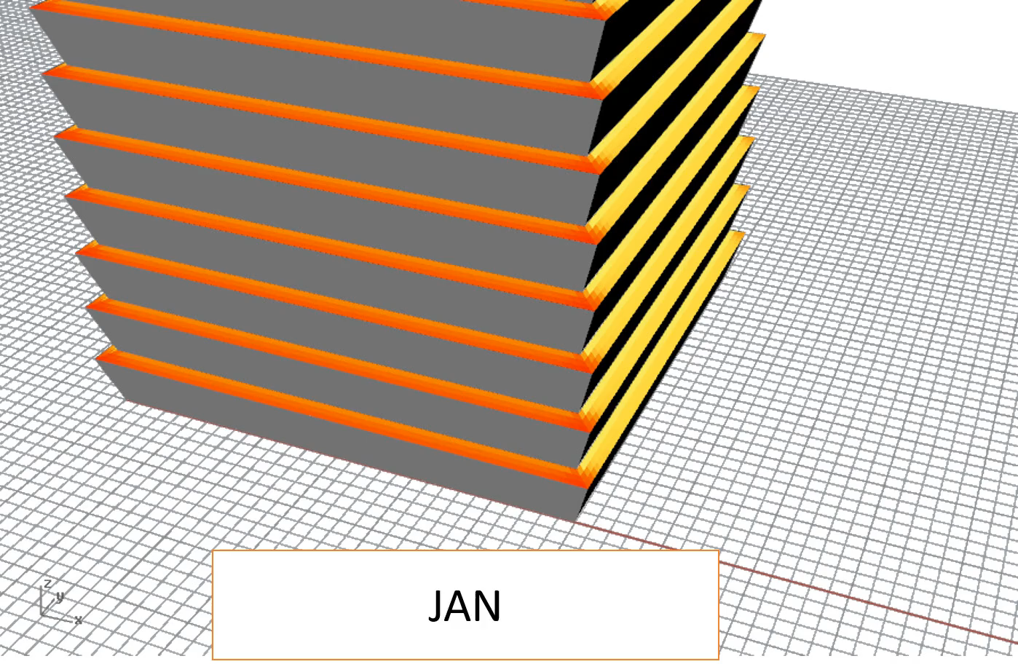
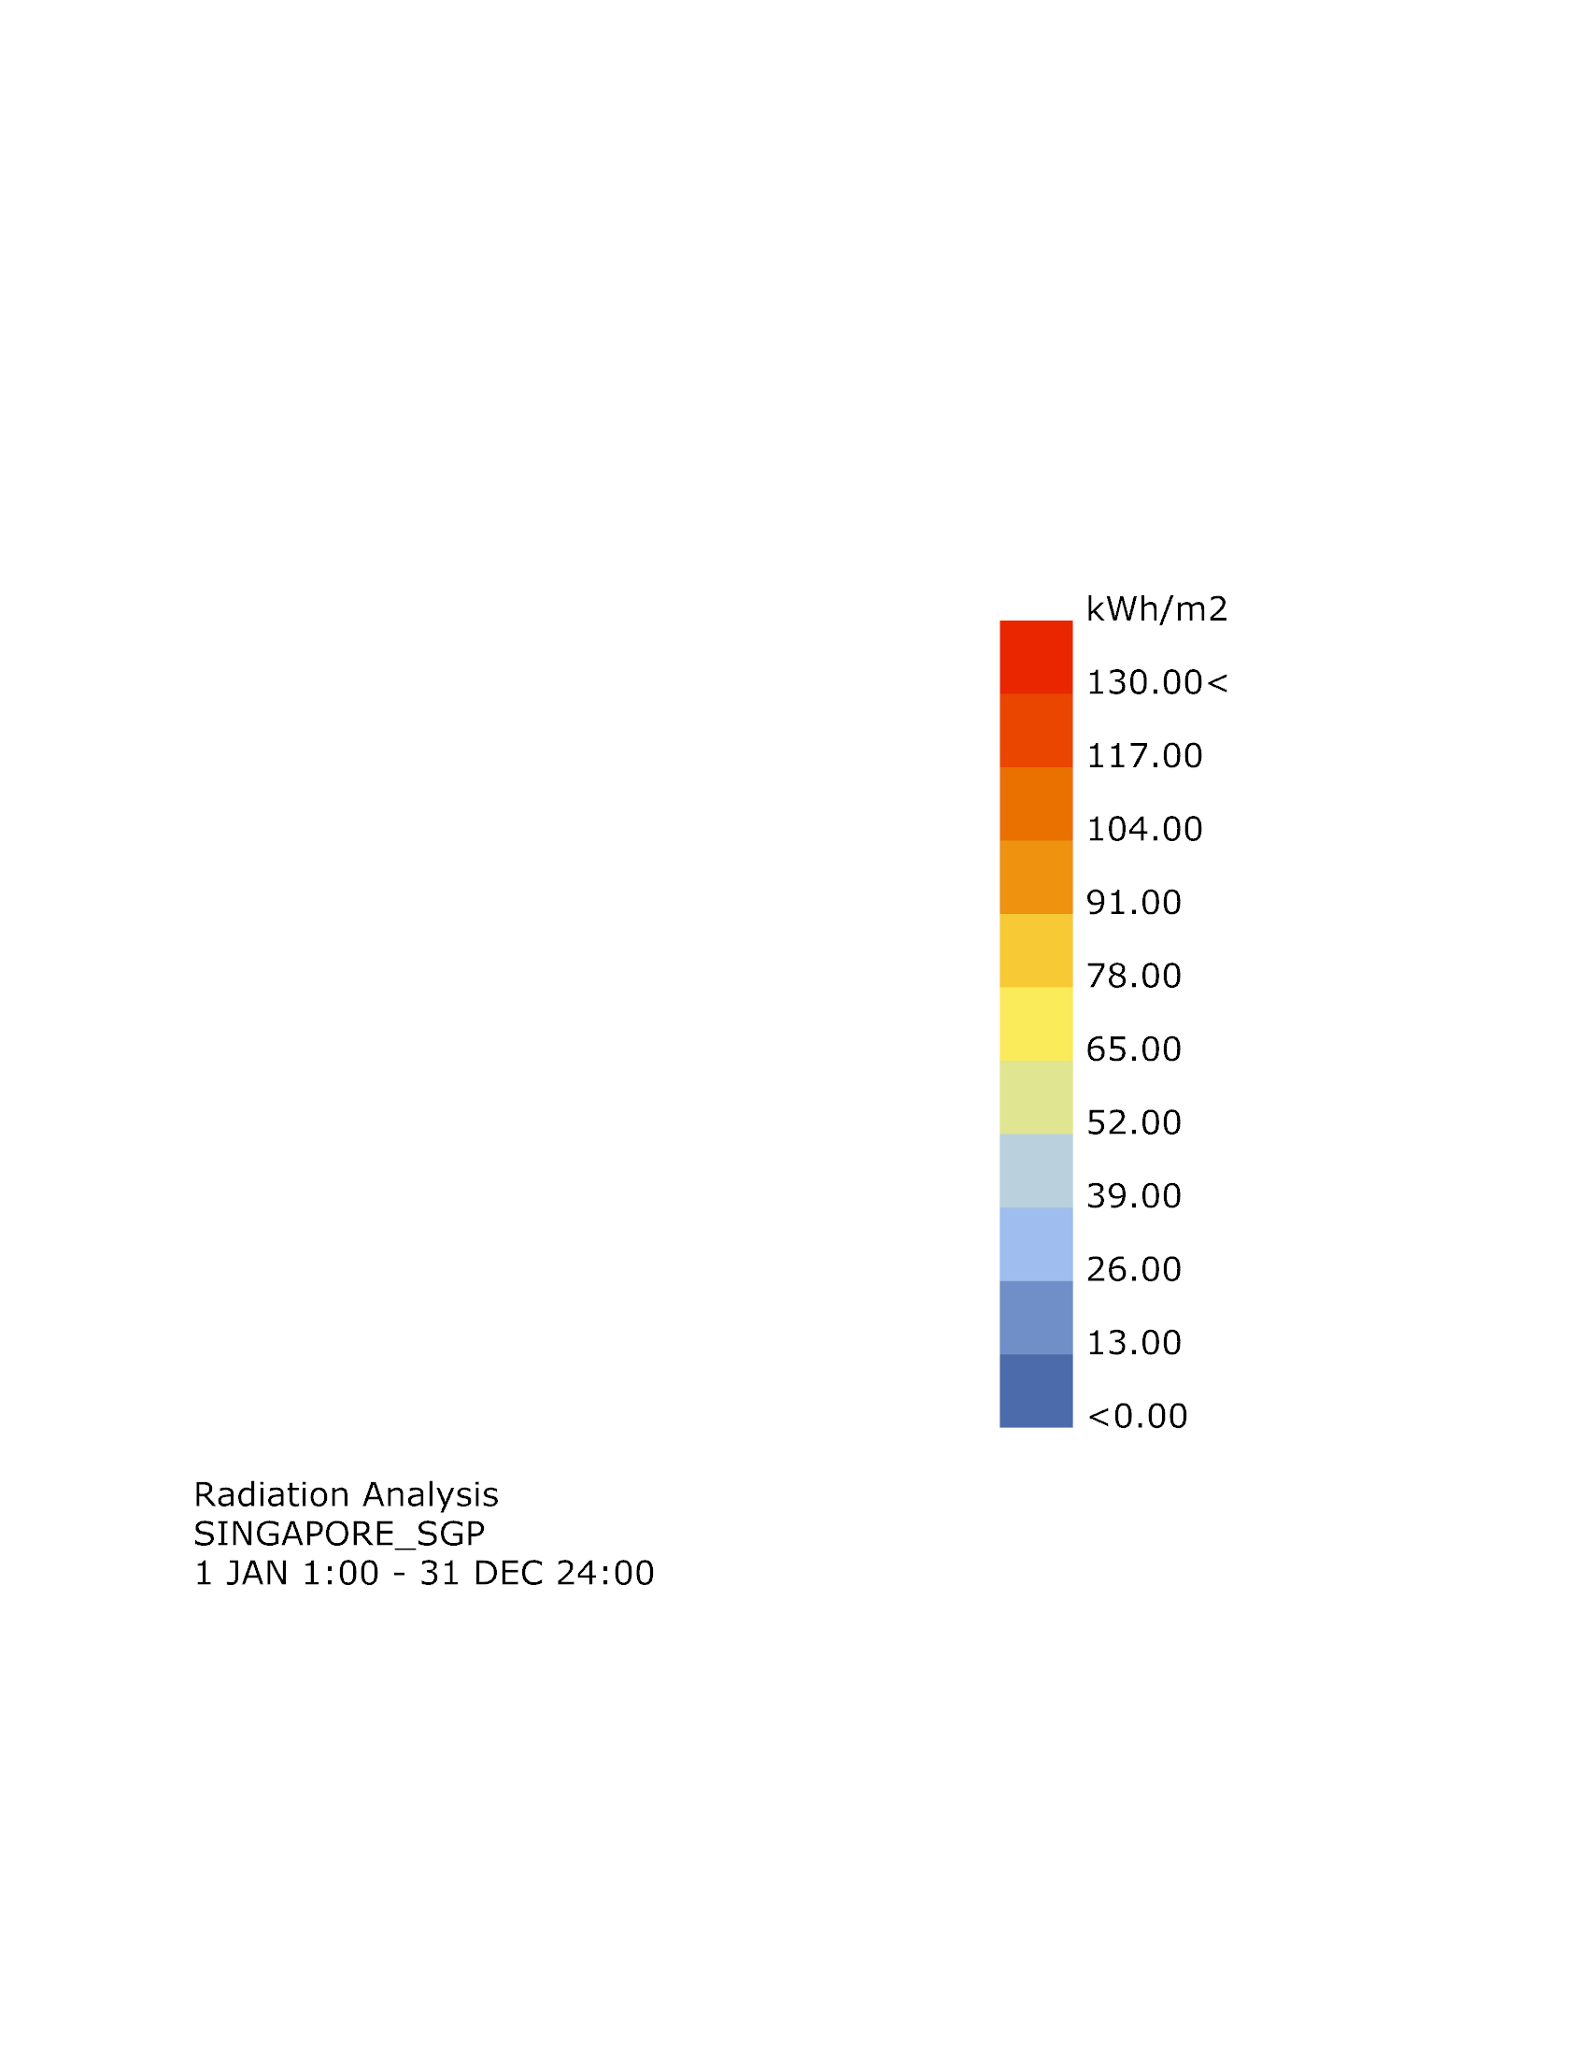
Solar radiation |Per facade
South
facade
East
facade

Slide 18

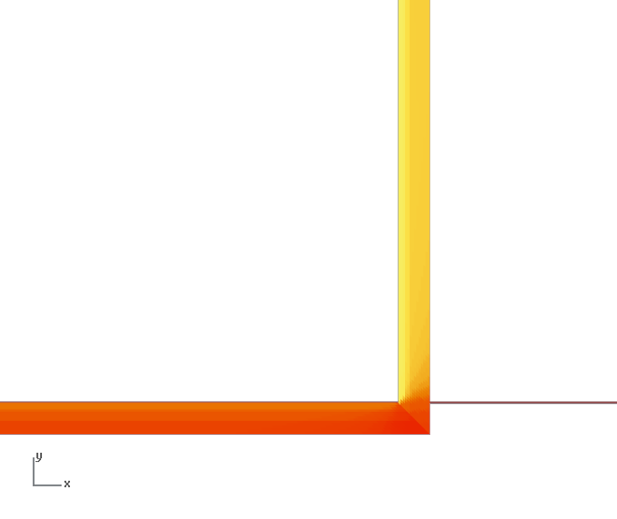
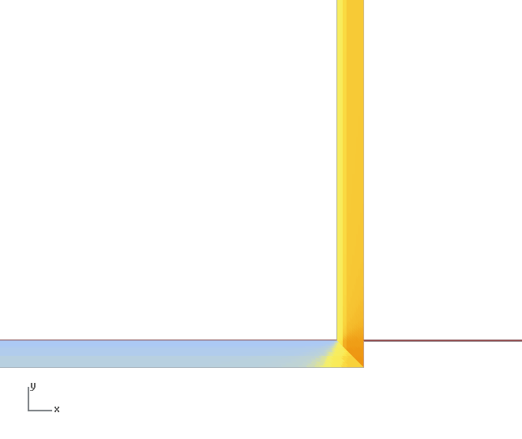
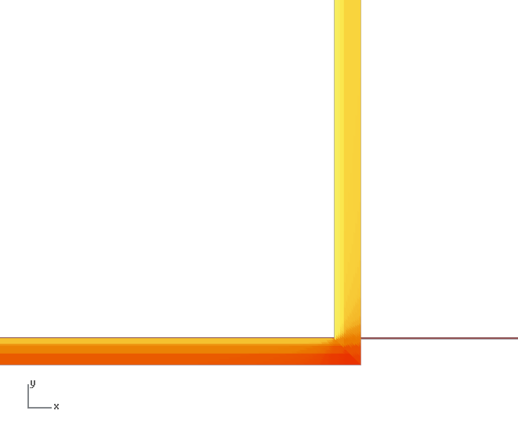
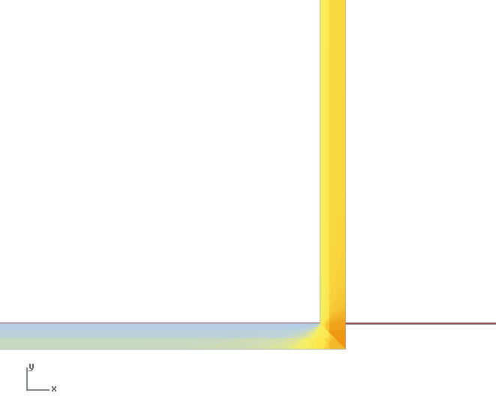
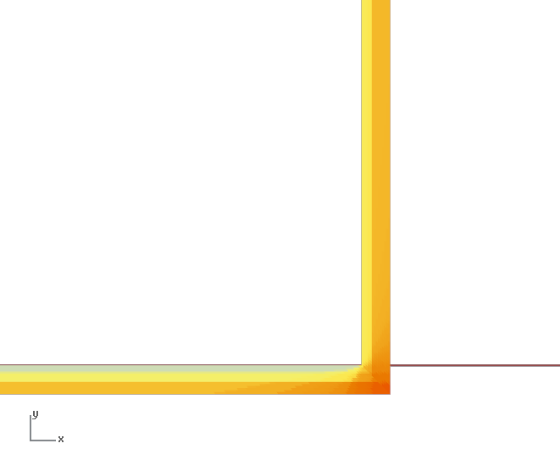
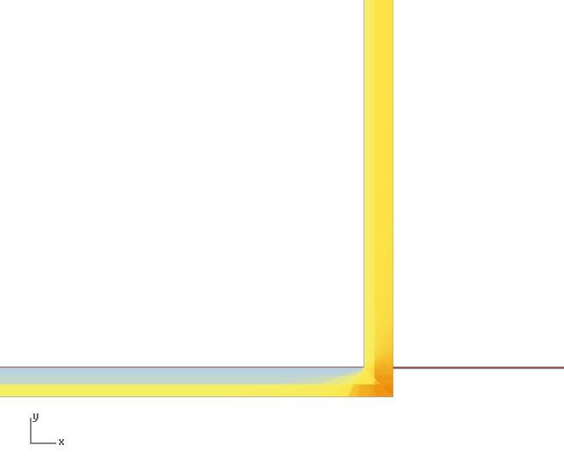

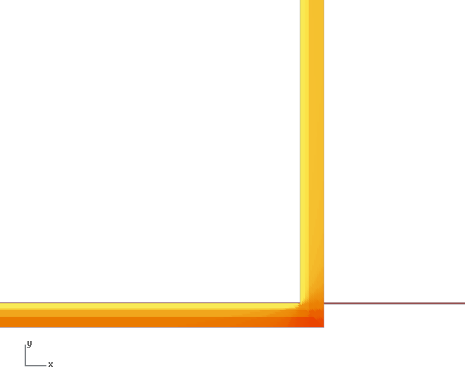



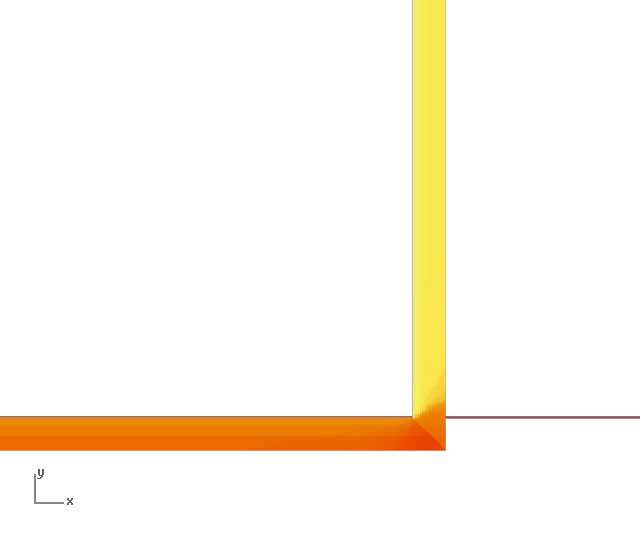
Shading pattern|Monthly E-S facade
East
facade
East
facade
South
facade
South
facade
Jan
Jul
Feb
Ago
Mar
Set
Apr
Out
Mai
Nov
Jun
Dec
Jan - Jun
Jul - Dec

Slide 19
























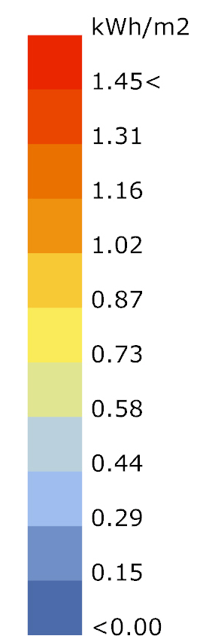
Shading pattern hourly|South façade
South
0.01
0.15
0.40
0.65
0.80
0.93
0.93
0.83
0.65
0.43
0.17
0.02
East
0.01
0.19
0.49
0.71
0.83
0.77
0.40
0.31
0.23
0.15
0.07
0.02
7:00
8:00
9:00
10:00
11:00
12:00
13:00
14:00
15:00
16:00
17:00
18:00

Slide 20
Solar radiation |Glass facade
3for2 façade receive already 35% less solar radiation than a flat façade.

Slide 21
Optimization studies
3for2 concept
Sun path
Validation of solar results
Status quo analysis
Optimization studies
Electricity production
Cooling loads
Trade-off analysis
Conclusion and discussion

Slide 22


Angles study | Vertical angle | Per facade
Overall better 40° (919.2 kWh/m2)
For North and South better 30°
For East and West better 40°
3for2 status quo

Slide 23
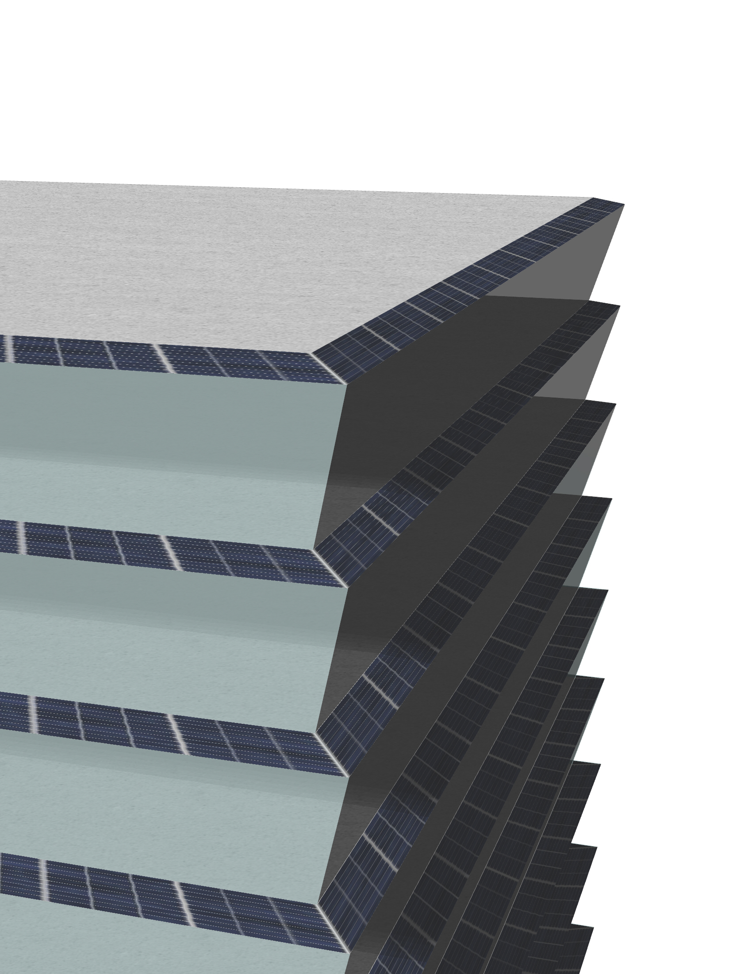
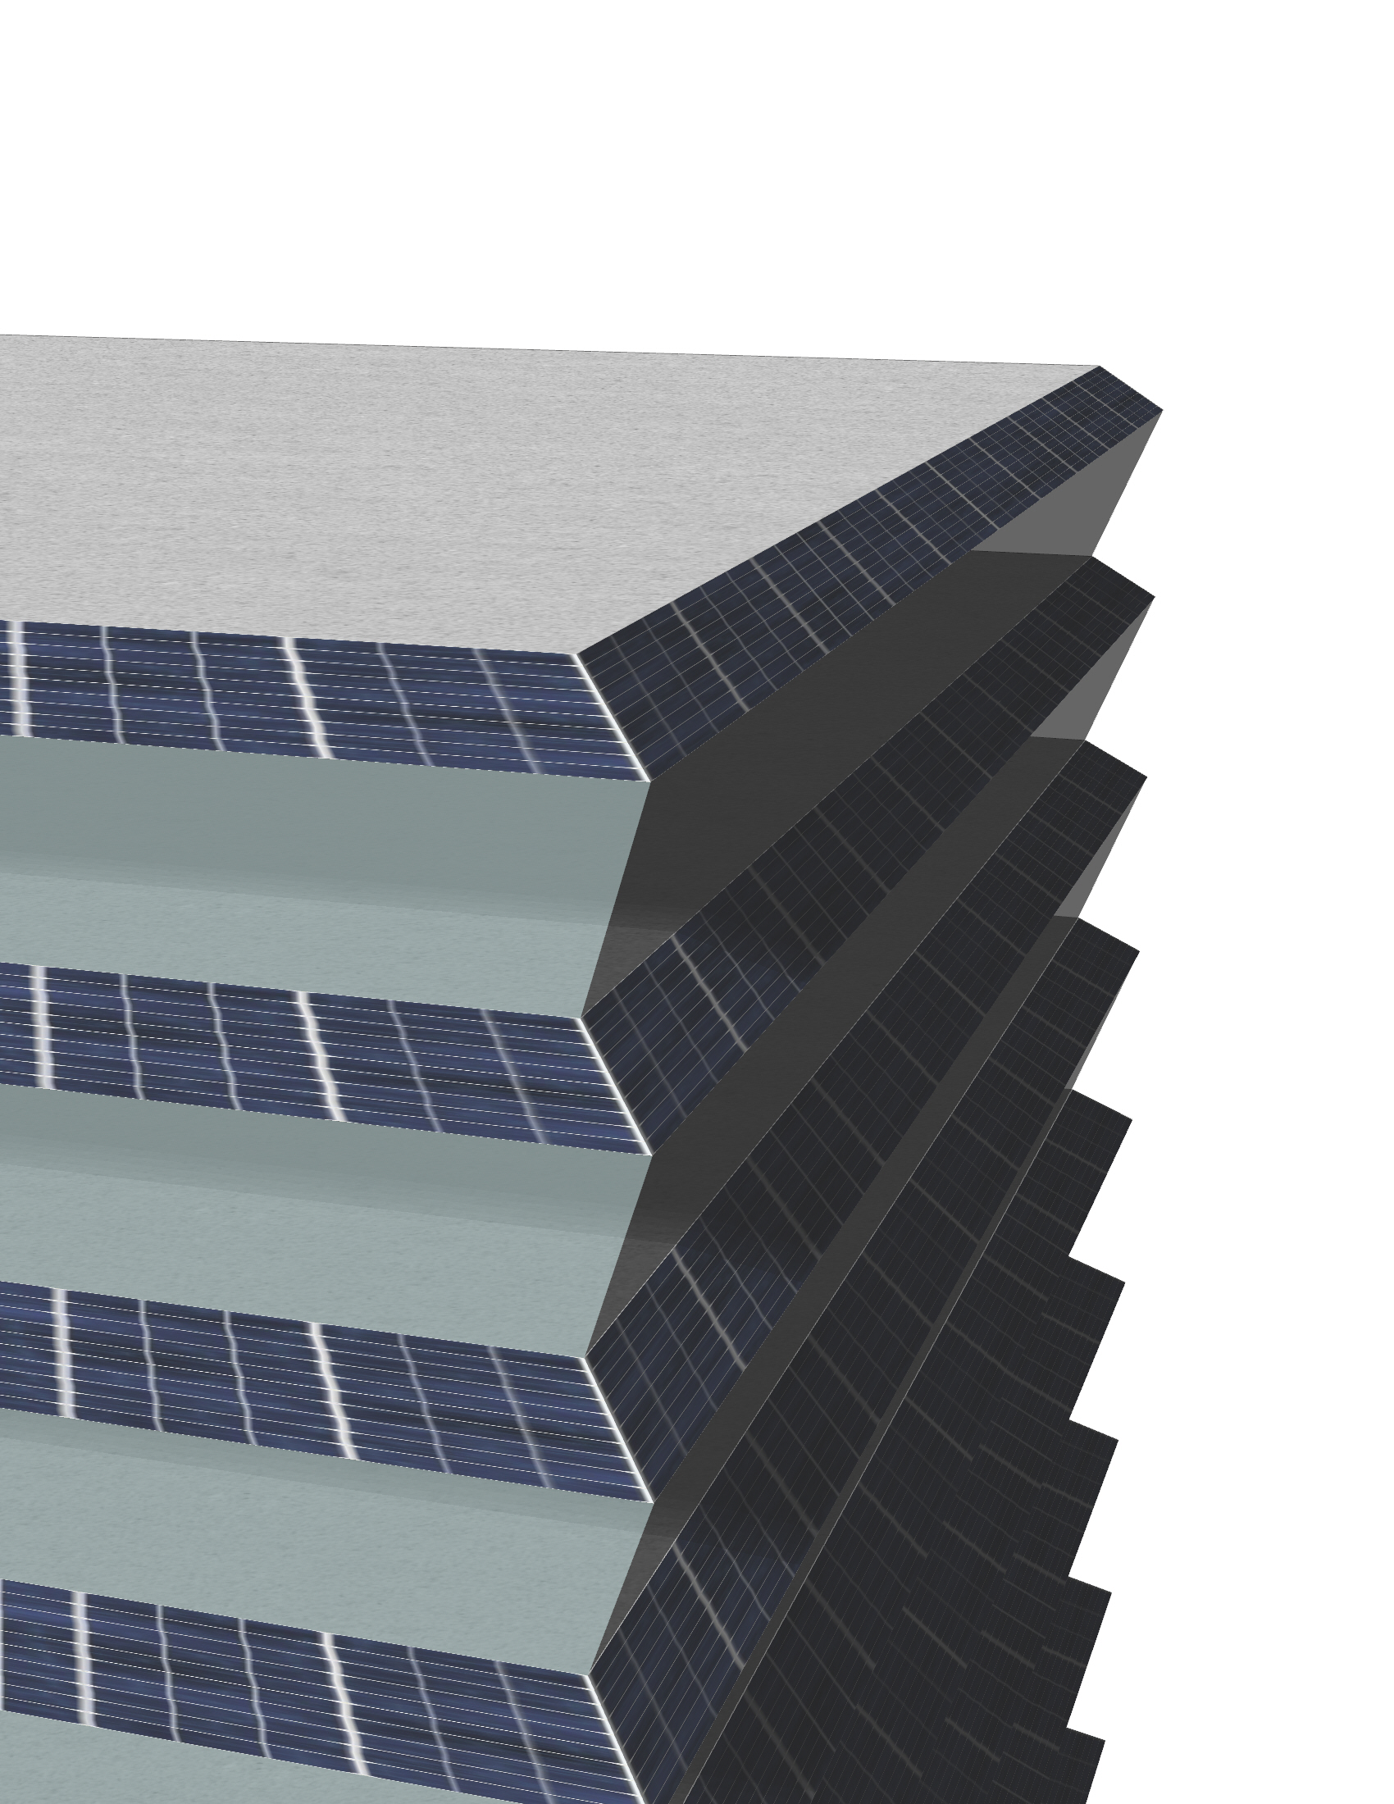
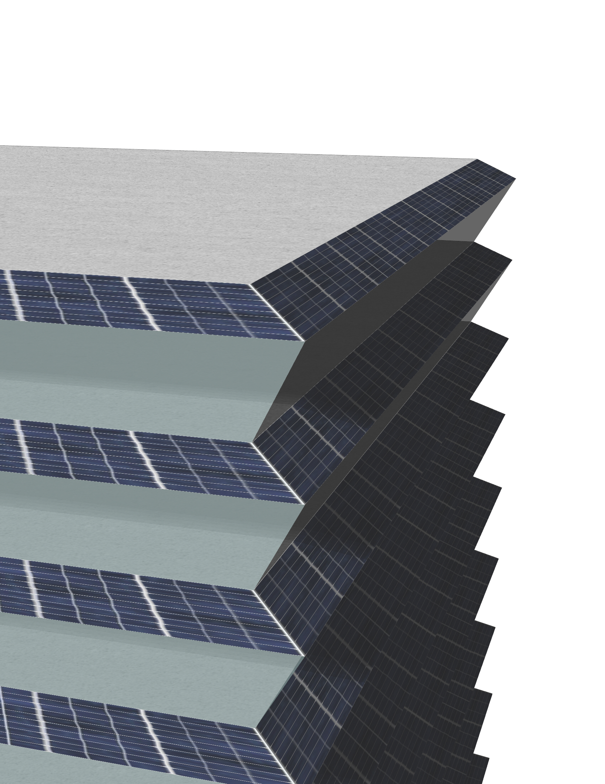
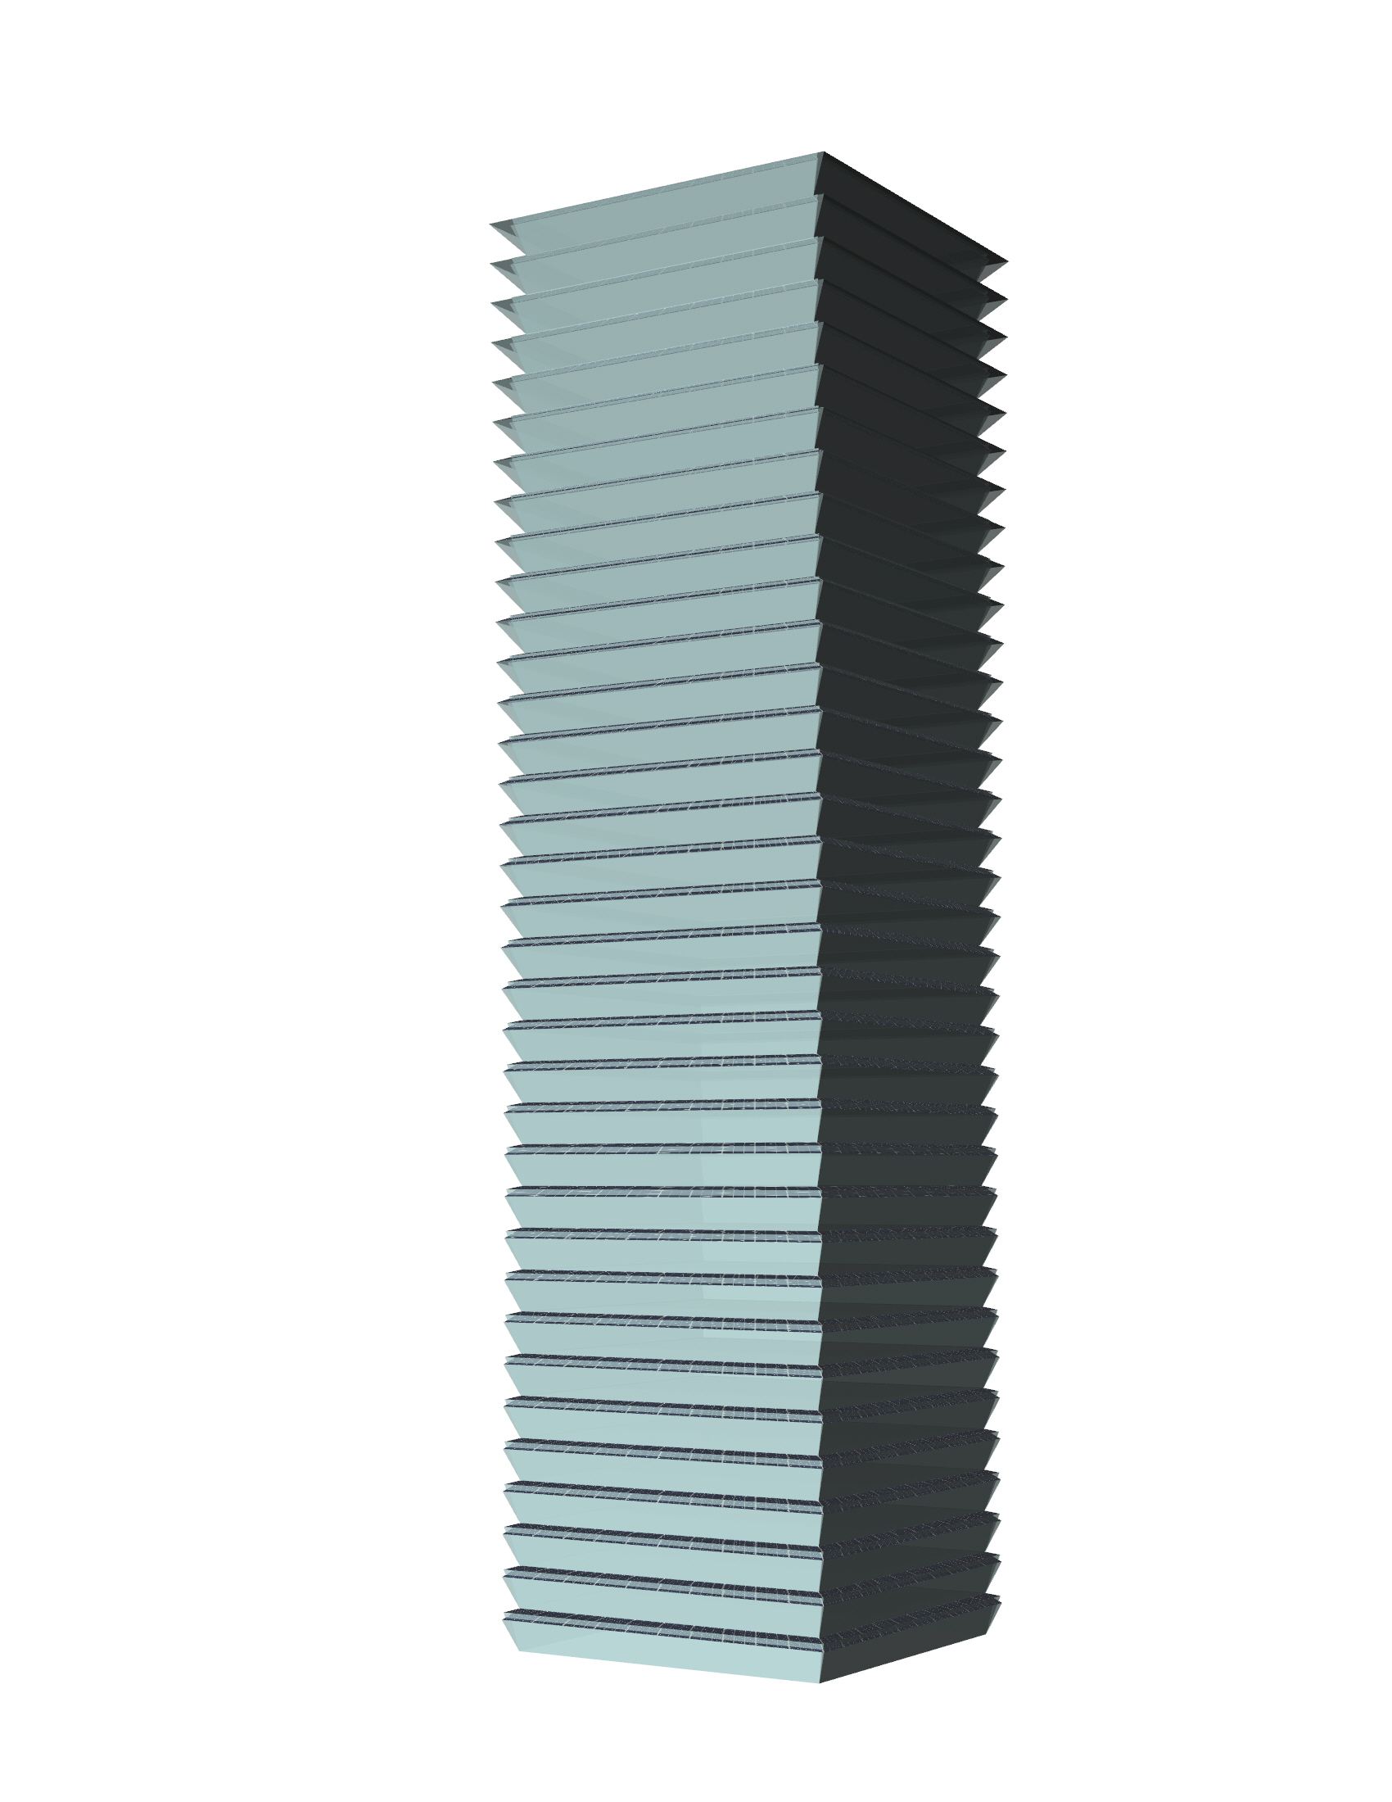
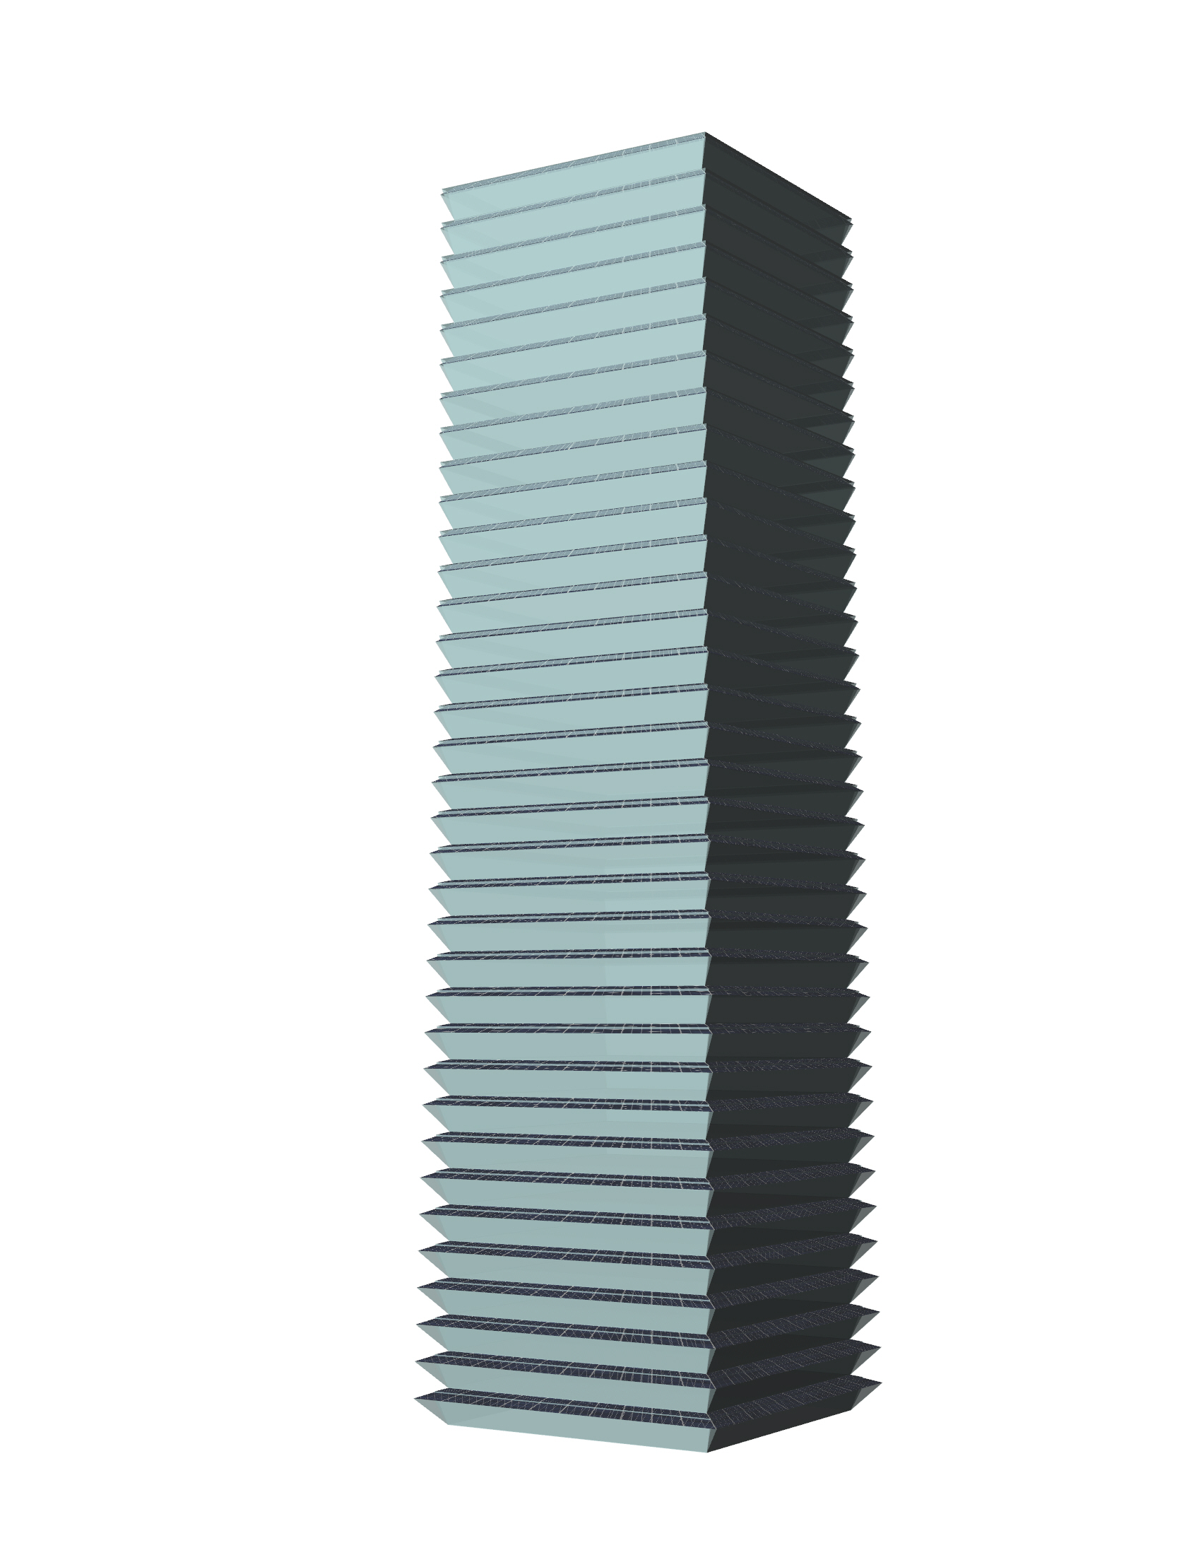
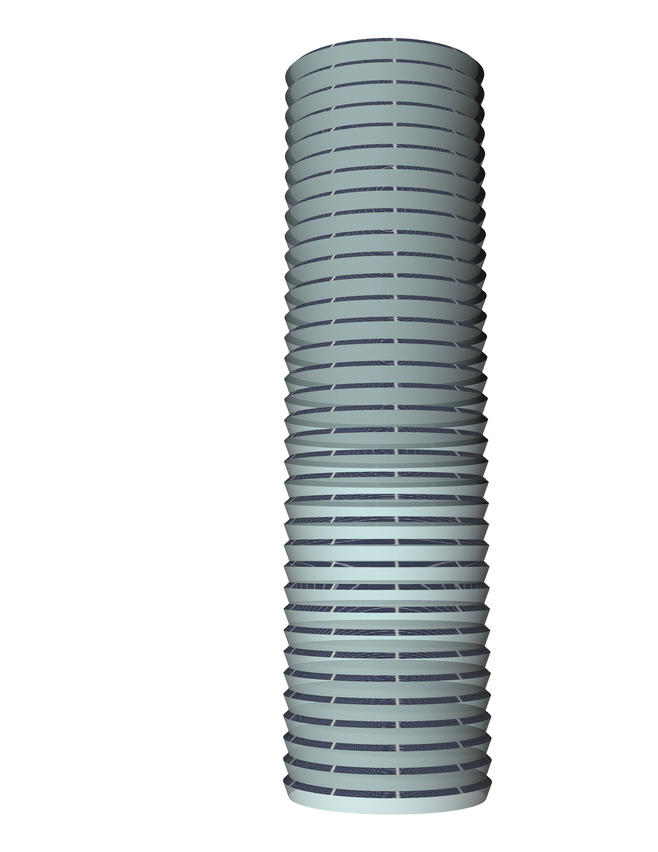
Different designs
3for2 status quo
3for2 40°
N|S 30° - E|W 40°
Bigger top
Bigger bottom
Circle
N|S 40° - E|W 30°
Image
Image
Image
Image
Image
Image

Slide 24

Orientation studies | Solar radiation
Changing orientation make some small difference independent of the option, e.g. 25 kWh/m2
3for2 (40°) perform fairly the same as circle but circle design doesn’t depend on orientation
Studies indicated that N-S facades would perform better with 30° and E-W with 40°, why they are not?

Slide 25
Different designs | Ranking | Year basis
Δ 83 kWh/m2

Slide 26
Electricity production
3for2 concept
Sun path
Validation of solar results
Status quo analysis
Optimization studies
Electricity production
Cooling loads
Trade-off analysis
Conclusion and discussion

Slide 27


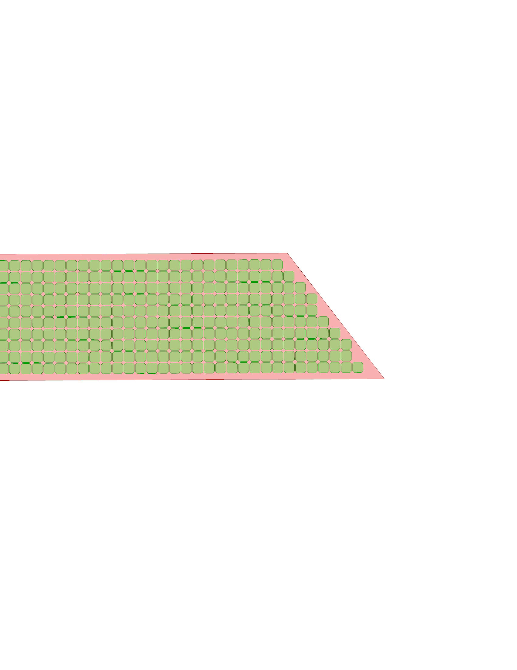
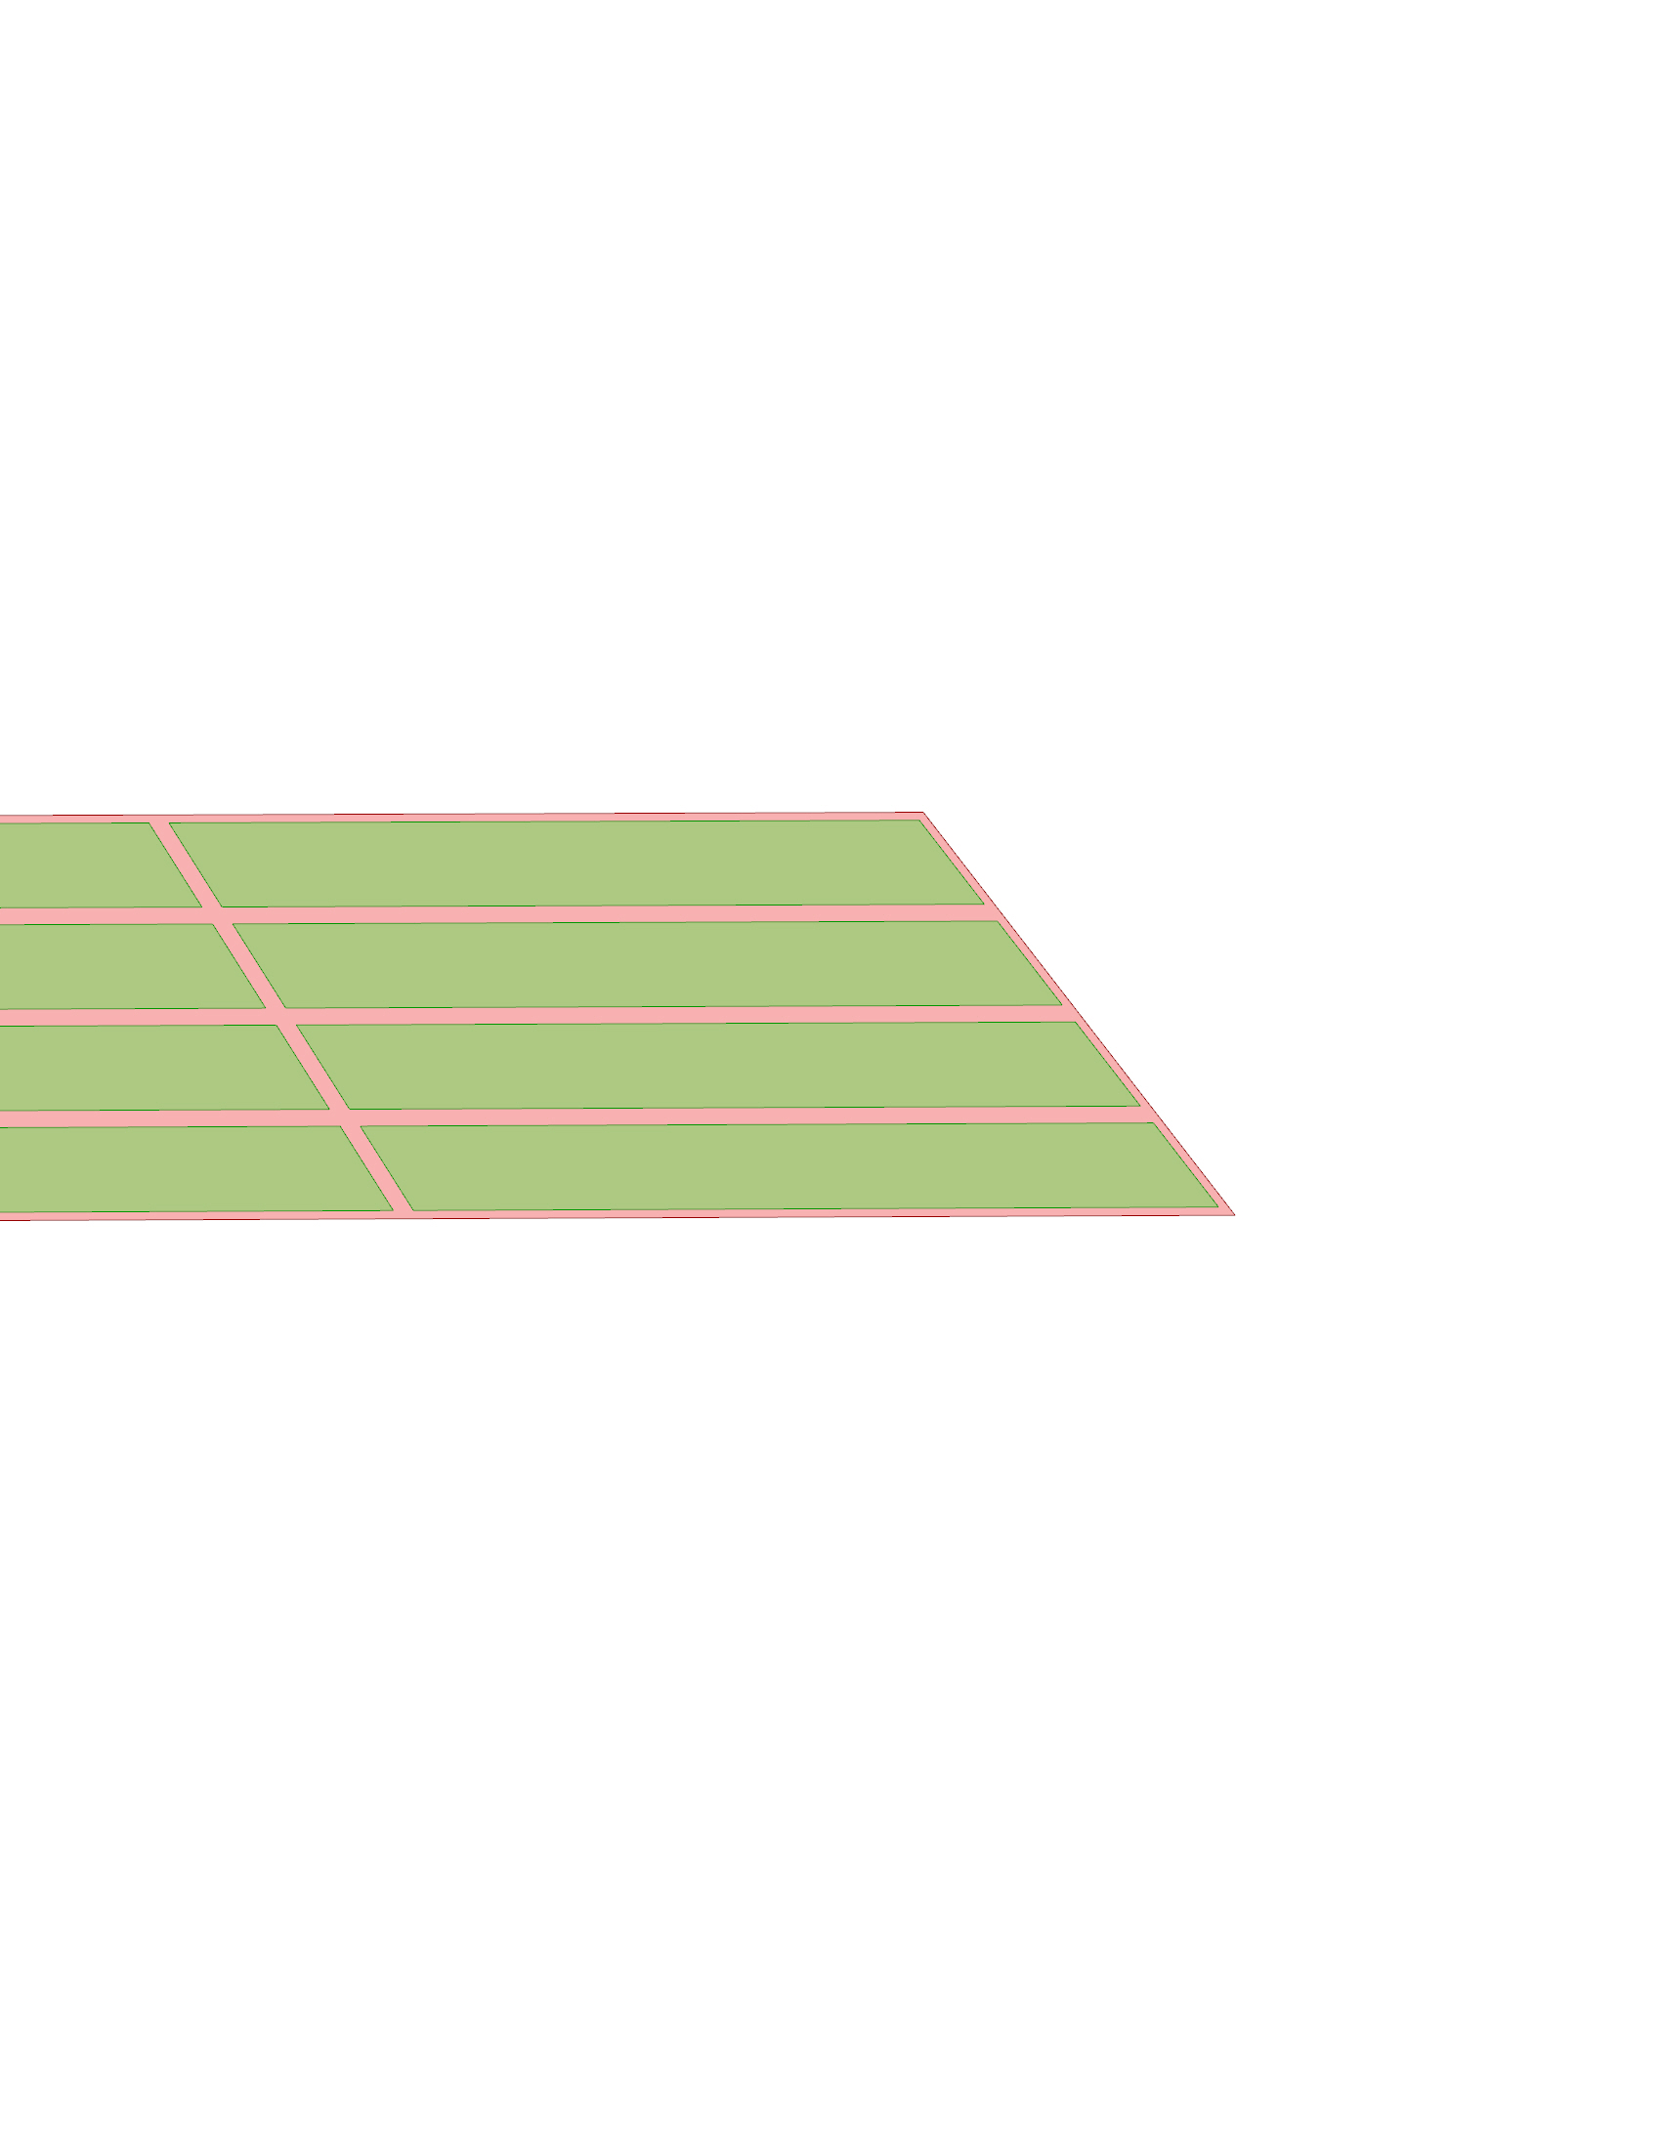
PV technology | Cells distributions
Shadow pattern
The same for all facades
Can it get better?
3for2 40° | 72.3% of total area
3for2 | 79.7% of total area
Monocrystalline
12.5 x 12.5 cm cells
Tilted cut CIGS
~ 87.5% of total area
Notes:
I couldn’t apply the cells over the whole building (too computational heavy) to get the total solar radiation, so I’ve decided to check for the area percentage. Is not ideal but it was the solution I came up.
I also don’t know if the CIGS can be tilted, but this would optimize the corners.
Don’t have the rectangular CIGS yet.

Slide 28
Better fill Monocrystalline cell | for 40°
3for2 40

Slide 29
Better fill Monocrystalline cell | for 40°
3for2 40
Option 1
Option 2
Option 3

Slide 30

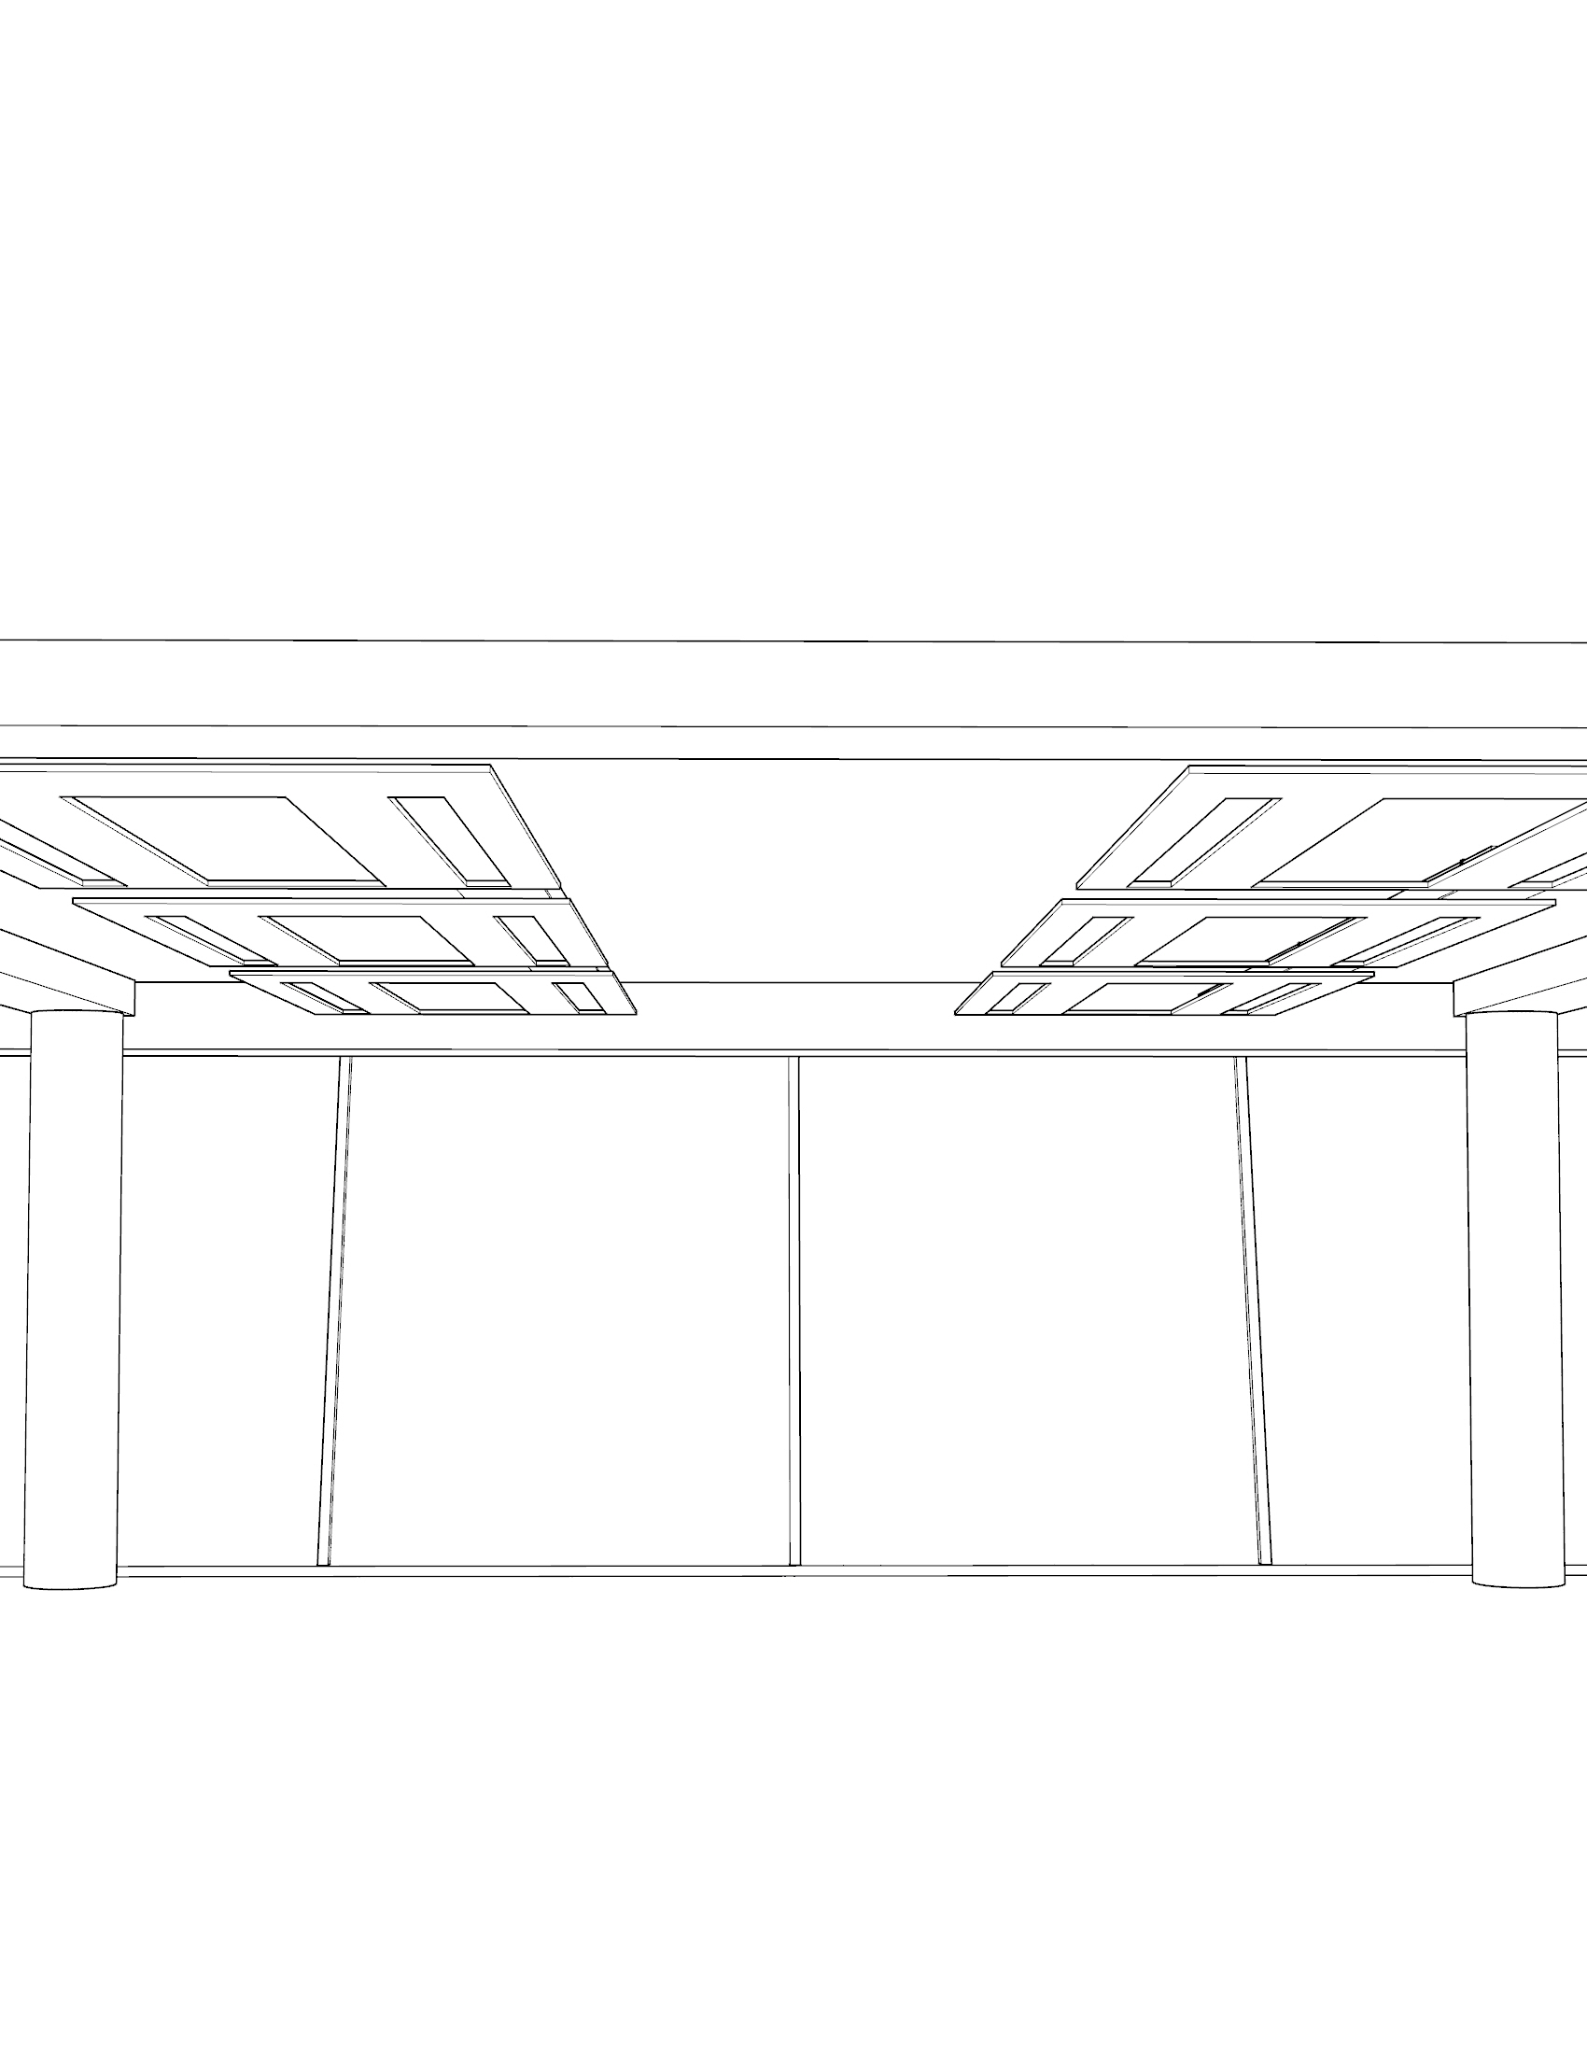
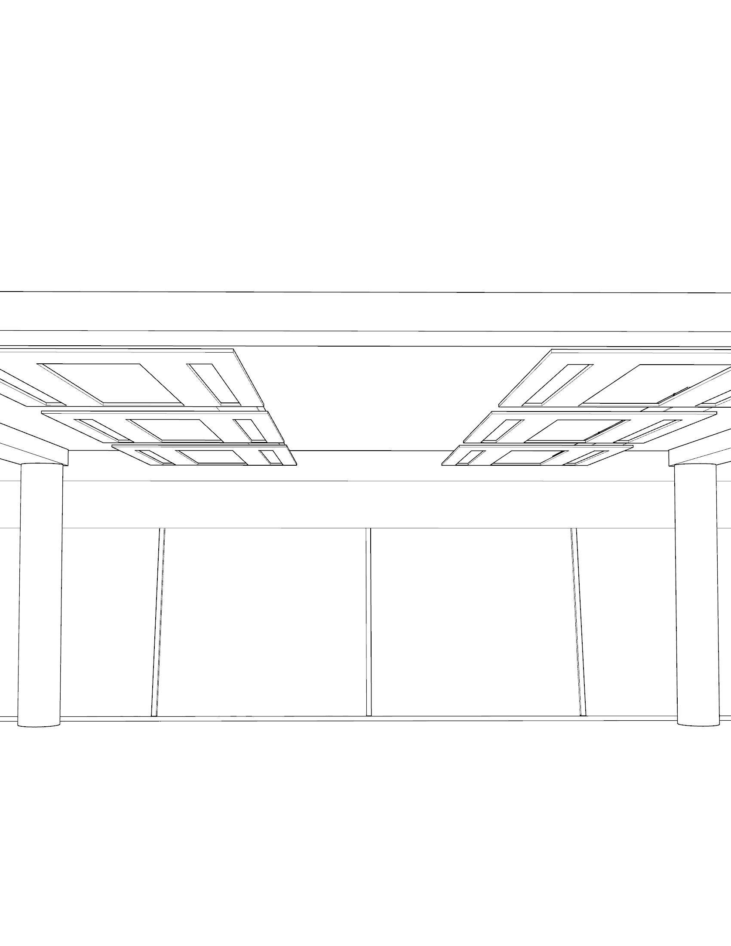

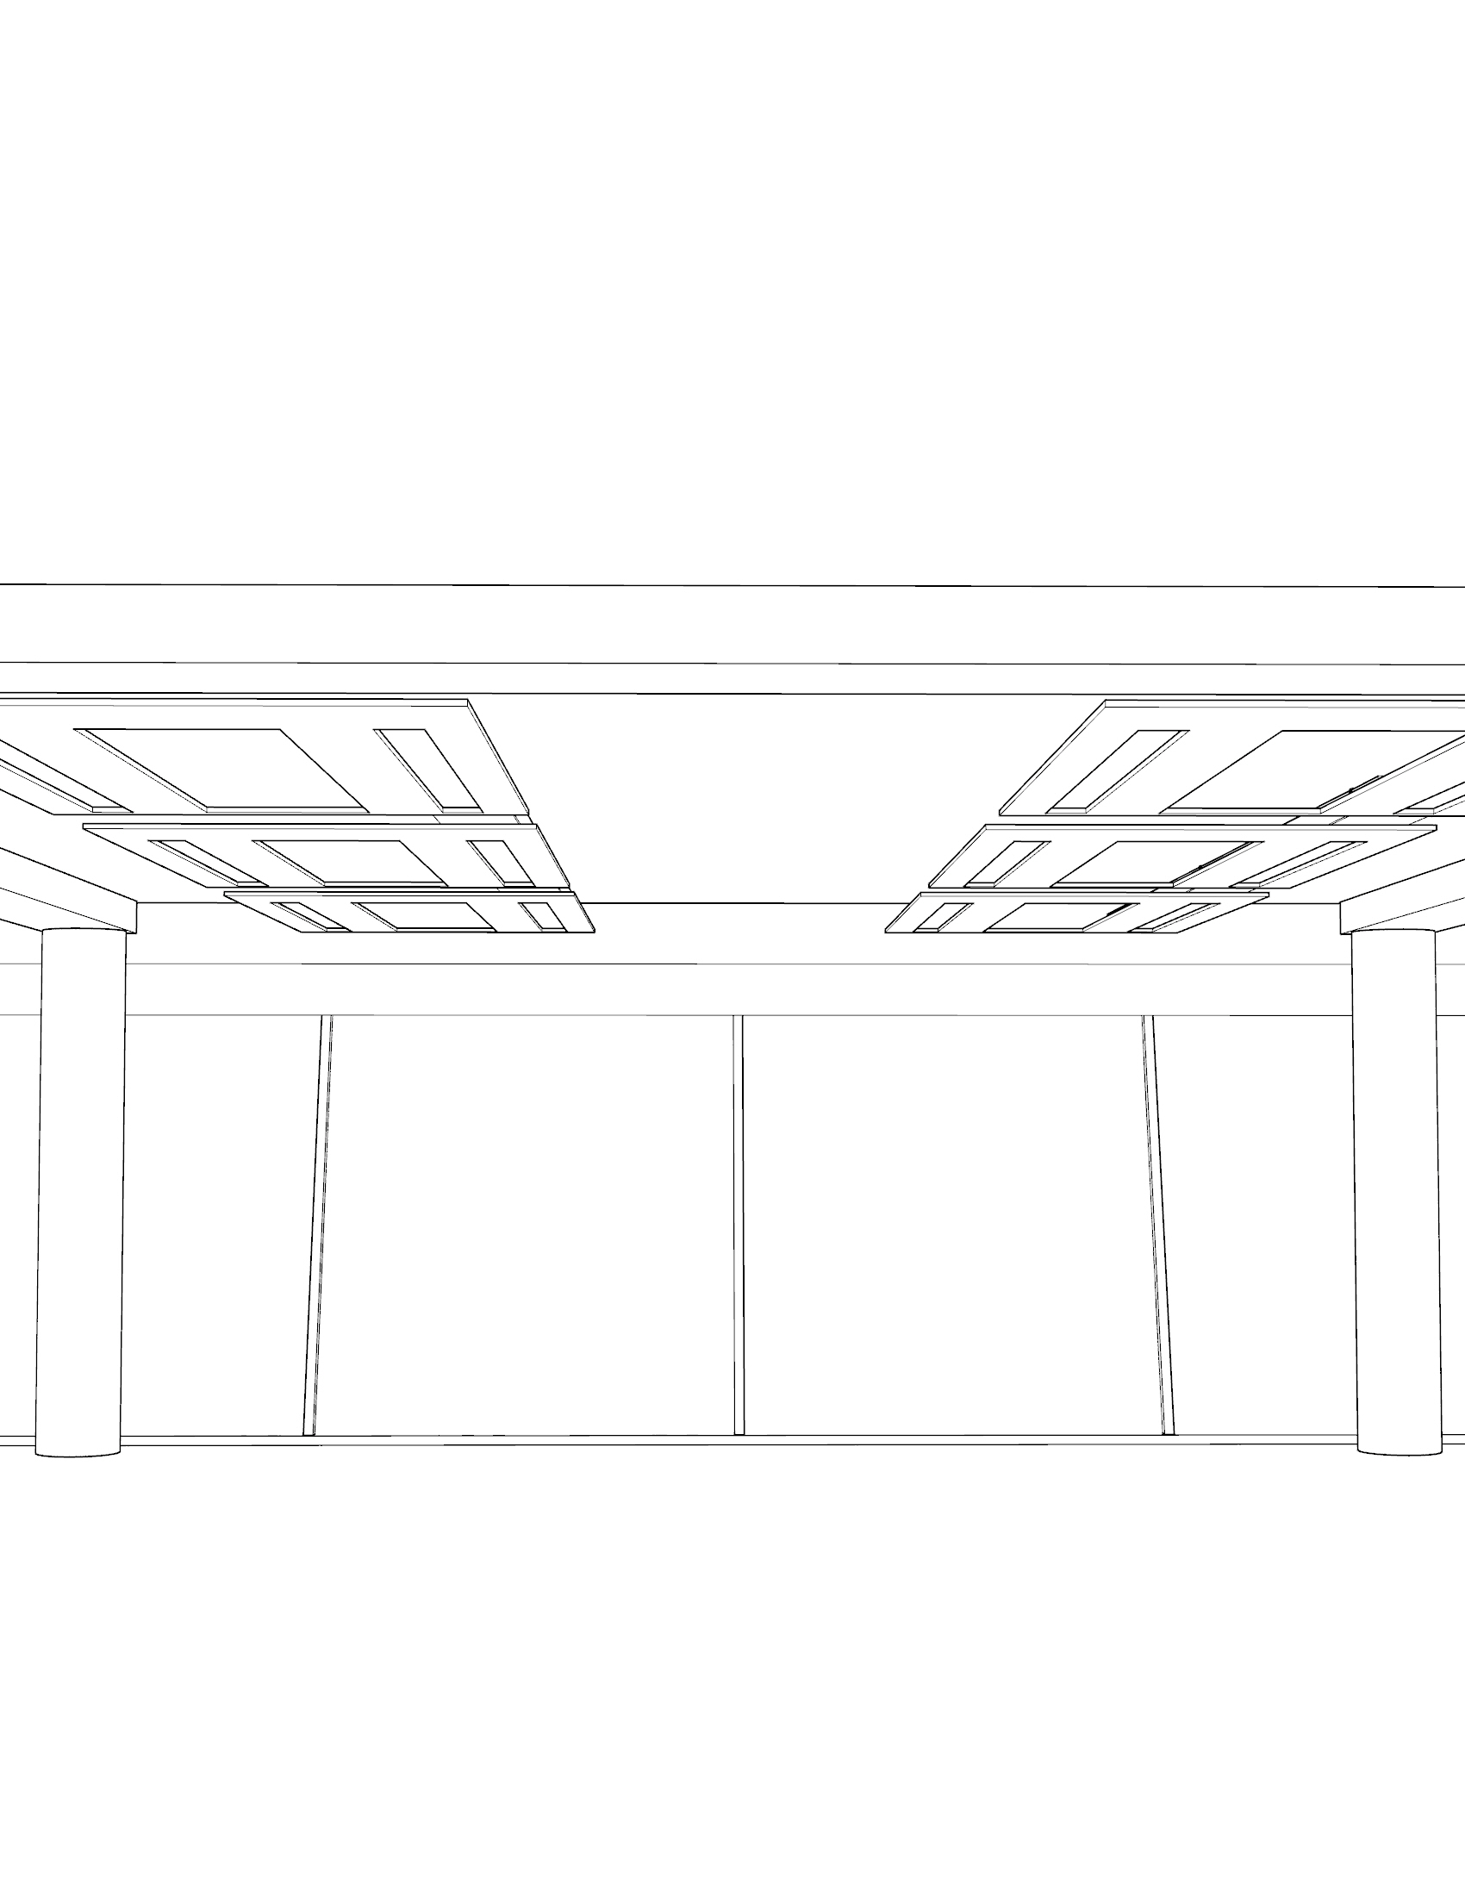
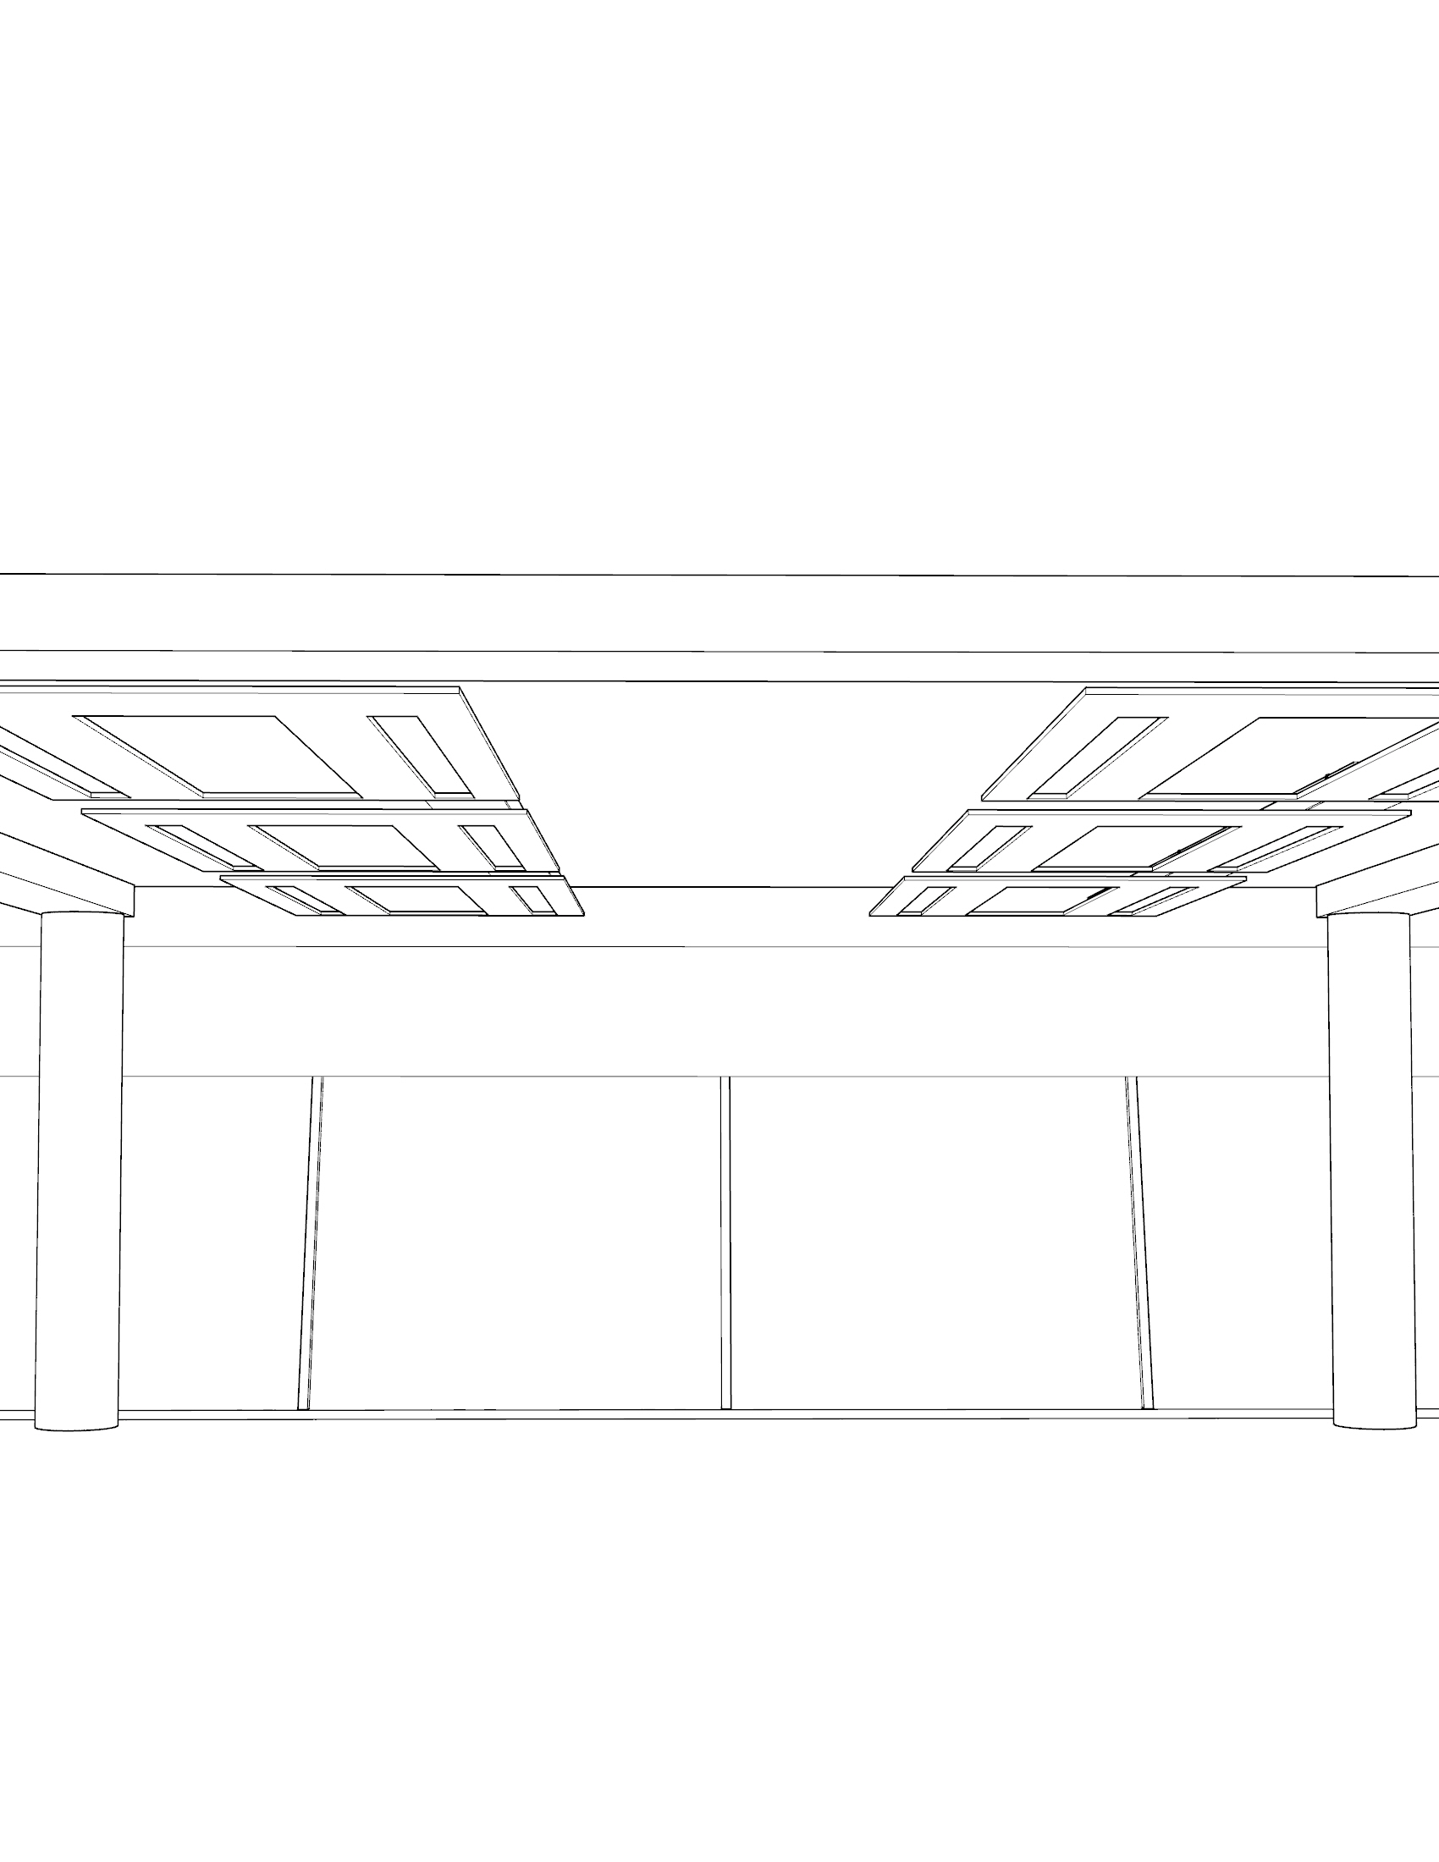
Trade-off Electricity production and views
Monocrystalline
Floor to floor: 3.65m
Slab thickness: 0.30m
3for2 original
Depth 1.0m | Height 0.3m
Option 2
Depth 1.4m | Height 1.2m
31% of total consumption
12% of facade obstruction
55% of total consumption
33% of facade obstruction
Depth of 0.8 (40°) has same view but bigger electricity production (35%)
Option 1
Depth 1.2m | Height 1.0m
Option 3
Depth 1.8m | Height 1.5m
50% of total consumption
27% of facade obstruction
66% of total consumption
45% of facade obstruction

Slide 31
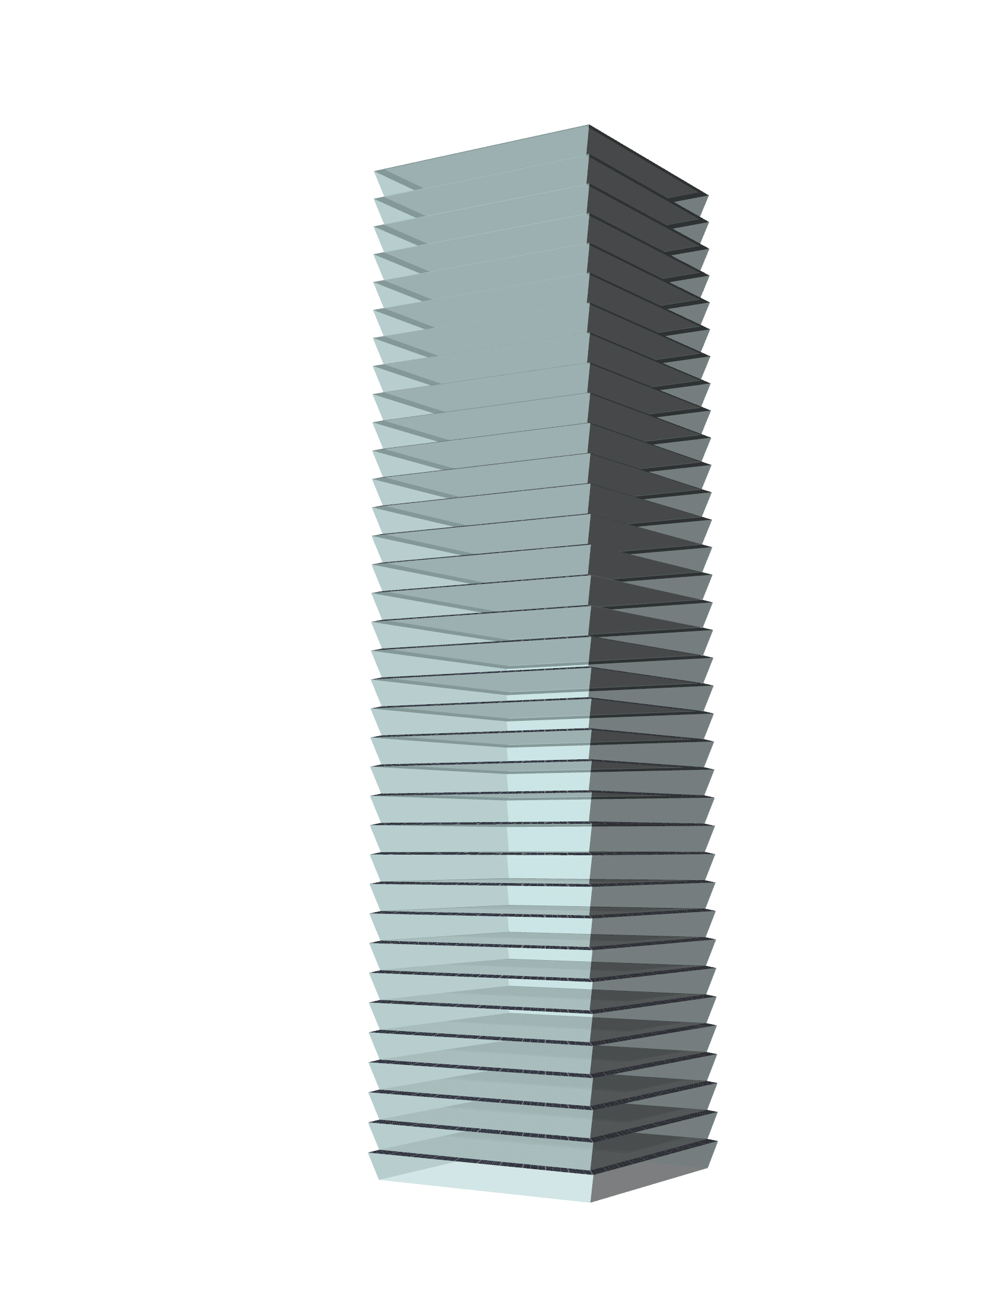
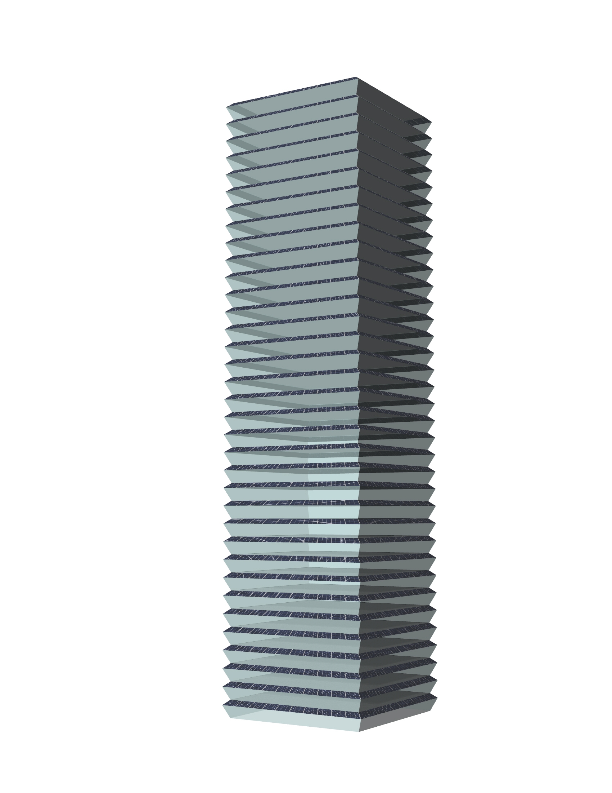
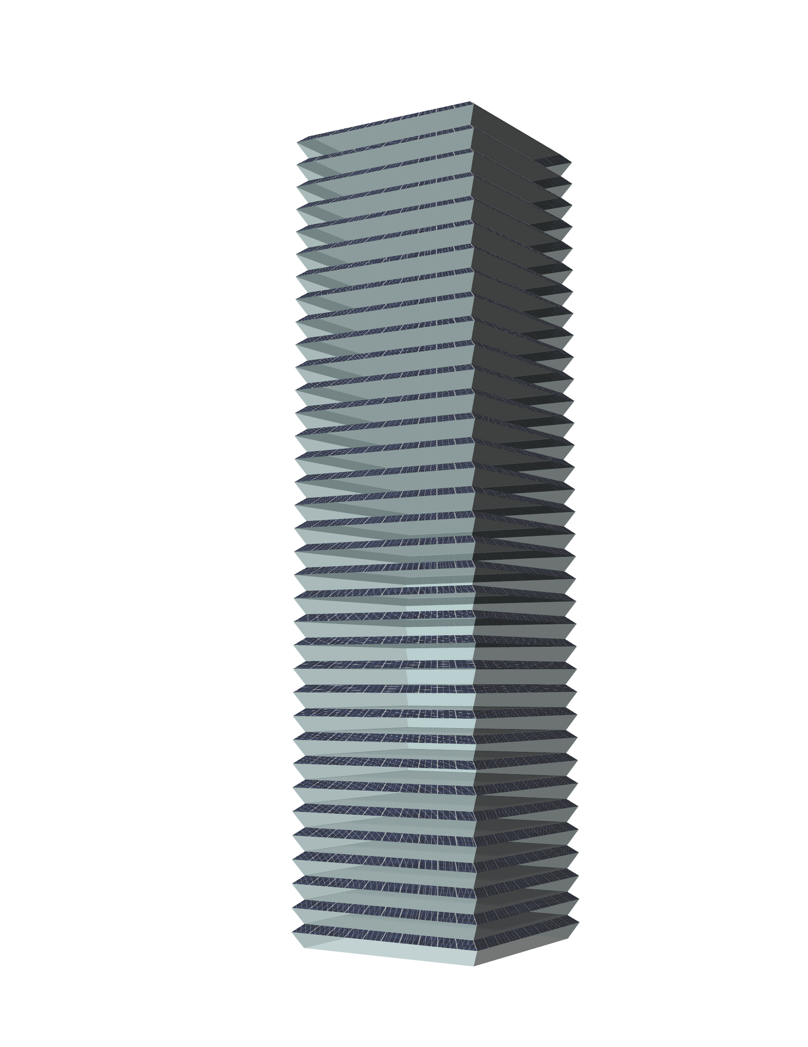
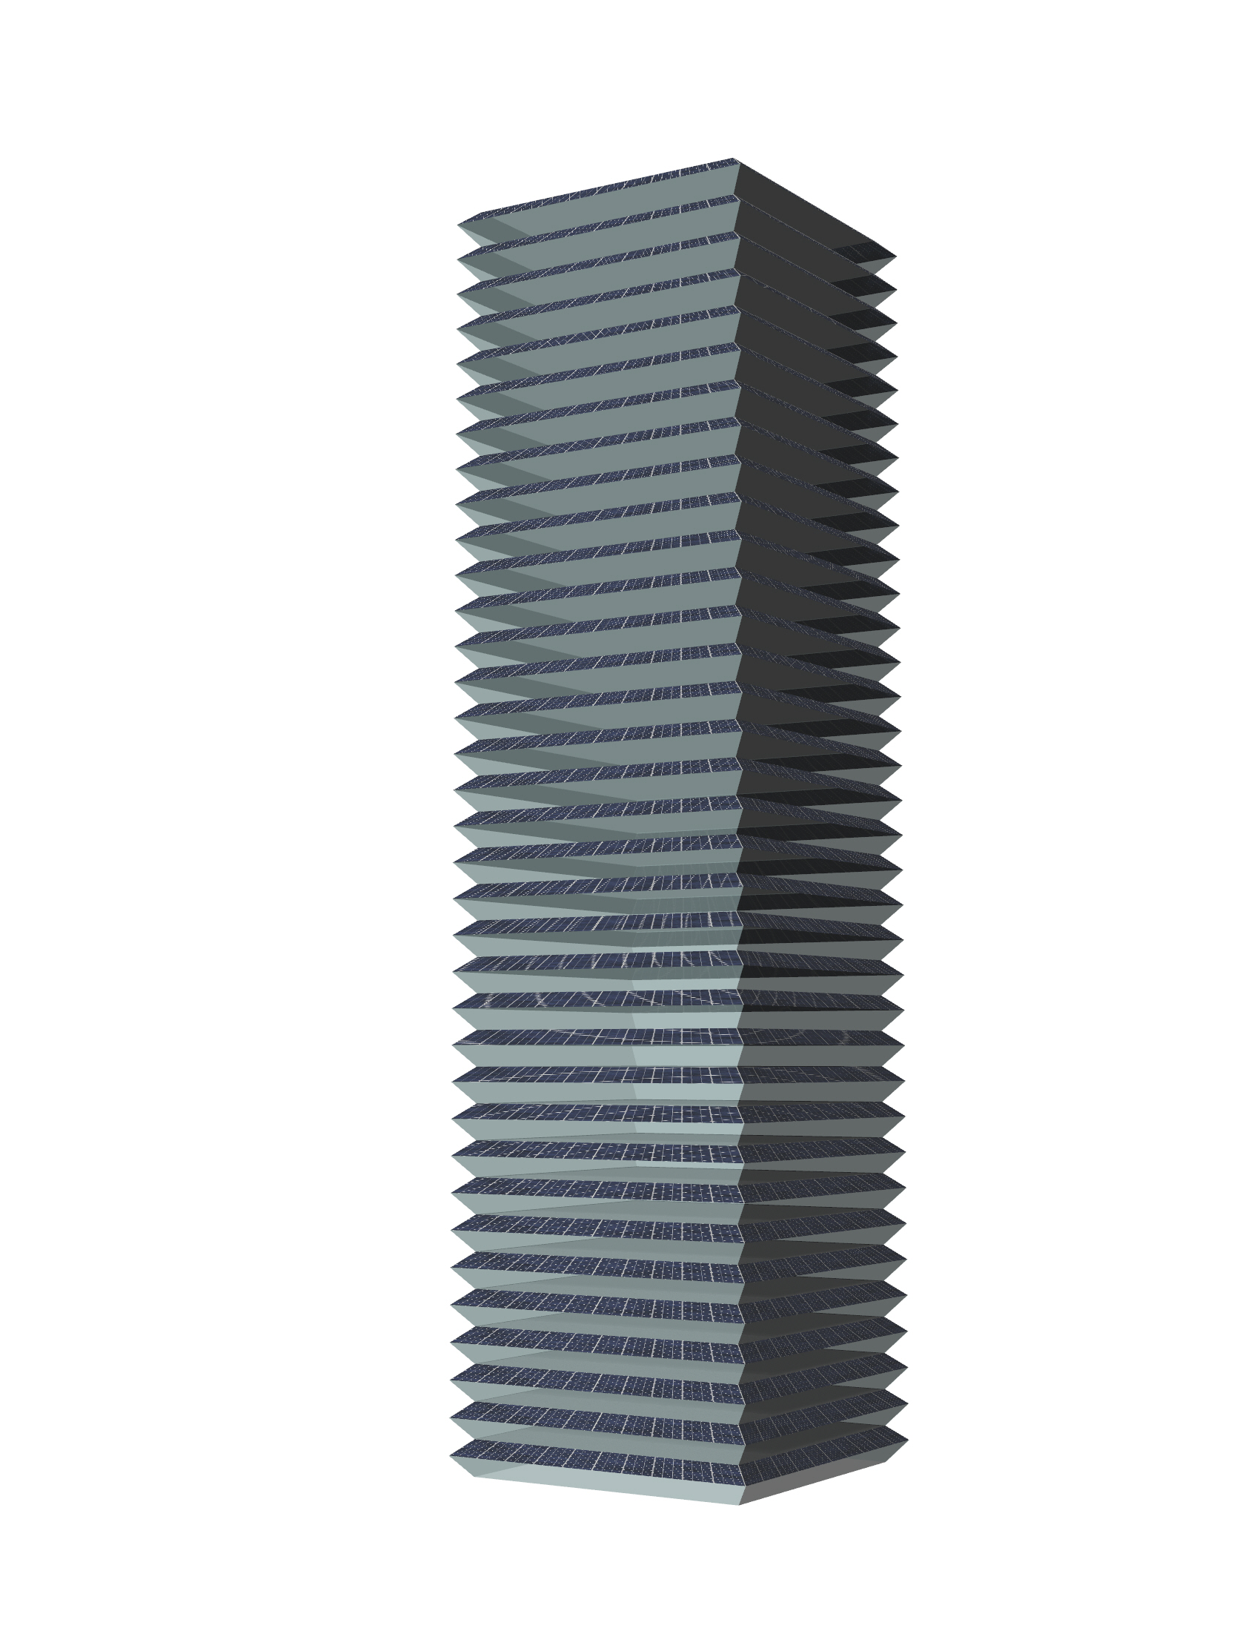
Different options | Angle fixed 40°
3for2 status quo
Option 1
Option 2
Option 3
Image
Image
Image
Image

Slide 32
Cooling loads
3for2 concept
Sun path
Validation of solar results
Status quo analysis
Optimization studies
Electricity production
Cooling loads
Trade-off analysis
Conclusion and discussion

Slide 33
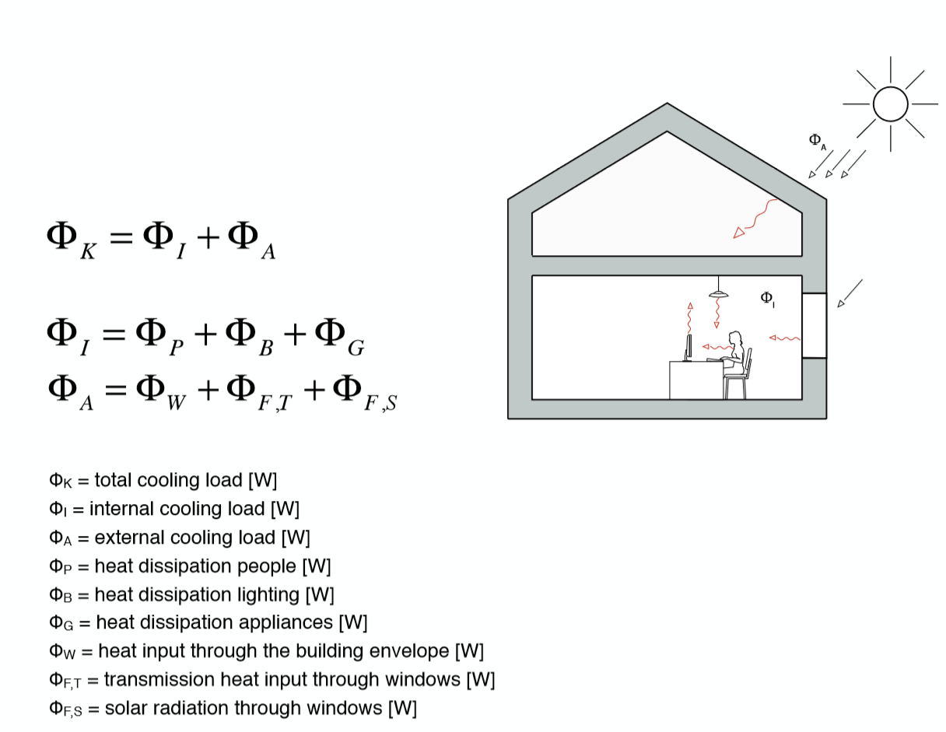

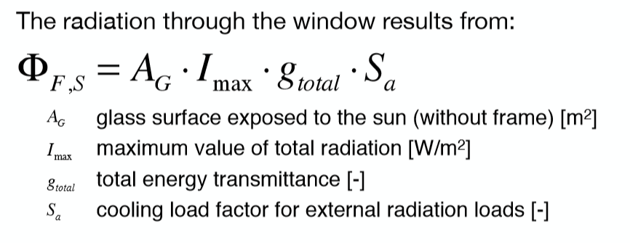
Cooling loads

Slide 34
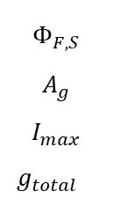
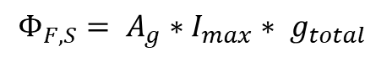
Cooling loads
No significant difference between the original orientation and the rotated for the 3for2 (40°)
$$Φ_{F,S}= A_{g}∗I_{max}∗ g_{total}$$
$$Φ_{F,S}$$
$$A_{g}$$
$$I_{max}$$
$$g_{total}$$
Solar radiation through windows
Area of glass surface (m2)
Solar radiation (kWh/m2)
g-value
Parameters and assumptions used
g-value | 0.6
S | suppressed
Glass area flat facade | 15’330.0 m2
Glass area (Status quo) | 15’172.9 m2
Glass area (40°) | 12’802.9 m2
Glass area option 1 | 12’678.8 m2
Glass area option 2 | 12’500.1 m2
Glass area option 3 | 12’449.4 m2
29%
35%
46%
64%
Notes:
Check if cooling loads are correct and add optinons 1, 2 and 3.

Slide 35
Cooling loads impact on total energy demand
Solar heat gains through windows accounts for 21% of the total energy demand
Self-consumption
6%
7%
10%
14%
Notes:
Check if cooling loads are correct and add optinons 1, 2 and 3.

Slide 36

Addition of roof electricity production

Slide 37
Trade-off analysis
3for2 concept
Sun path
Validation of solar results
Status quo analysis
Optimization studies
Electricity production
Cooling loads
Trade-off analysis
Conclusion and discussion

Slide 38

Trade-off analysis
Monocrystalline
Floor to floor: 3.65m
20%
Slab thickness: 0.30m
40%
60%
80%
100%
60% of roof included

Slide 39
Conclusion and discussion
3for2 concept
Sun path
Validation of solar results
Status quo analysis
Optimization studies
Electricity production
Cooling loads
Trade-off analysis
Conclusion and discussion

Slide 40

Conclusions and discussions
The horizontal design of 3for2 façade is good option – just needed better vertical angle;
This type of façade design harvest roughly half of the global horizontal radiation, in terms of kWh/m2;
Cooling loads (solar heat gains) are intrinsically related to PV design and its area, and it can contribute to decrease over 10% of energy demand*;
The overall self-consumption of options vary from 31% (status quo) up to 77% (option 3)* - 61% for option 2 that does not obstruct too much the façade;
Roughly, the roof can adds up to 9%-10% of the different options self-consumption*
Rotation of 5° can increase a little the solar radiation intensity but in general orientation does not play a big role
Area plays a really big role on the total electricity production – in which ways could we increase it?
Pay attention on the cell design to take the most advantage of the available panel area - mixing design?
*considering total floor area of 31’500m2

Slide 41
Thank you!
3for2 concept
Sun path
Validation of solar results
Status quo analysis
Optimization studies
Electricity production
Cooling loads
Trade-off analysis
Conclusion and discussion

Slide 42
Backup slides

Slide 43
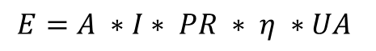
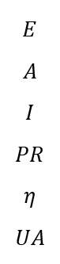
Electricity production | used parameters
$$E=A ∗I∗ PR ∗ η ∗UA$$
Parameters and assumptions used
Total floor area |  | 31’500 m2
PR |  | 75%
CIGS | Efficiency | 16%
 | Useful area | 87.5%
M-crystalline | Efficiency | 20%
 | Useful area | 72% - 80%
Estimated consumption |  | 47.4 kWh/m2/y
$$E$$
$$A$$
$$I$$
$$PR$$
$$η$$
$$UA$$
Total electricity (kWh)
Area (m2)
Solar radiation (kWh/m2)
Performance ratio
Cell efficiency
Useful area
Notes:
Please note the PR. I’ve increased because I’ve considered the cell area.

Slide 44
Further exploration
Further exploration of this project could be:
Cell design - mixed implementation of PV technologies on the panels to take better advantage of the corners;
Impact of cooling design for the PV panels;
Impact of natural lighting on the usage of artificial lighting;
Implementation of a double facade and its impact on energy demand from further shadowing - of the inner glass panel - and air insulation between panels;
Elaboration of an economic analysis;
Asses the performance of the concept on a real urban area.

Slide 45

Weather file
https://www.youtube.com/watch?v=AdViqWPwr7c&feature=youtu.be
“The EPW files were compiled from TMY, TMY2, TMY3, and other international datasets.”¹
“Users of energy simulation programs should avoid using single year, Test Reference Year-type (TRY) weather data. No single year can represent the typical long-term weather patterns. More comprehensive methods that attempt to produce a synthetic year to represent the temperature, solar radiation, and other variables within the period of record are more appropriate and will result in predicted energy consumption and energy costs that are closer to the longterm average. Both Typical Meteorological Year 2 (TMY2) and Weather Year for Energy Calculations 2 (WYEC2) use this type of method, are based on improved solar models, and more closely match the long-term average climatic conditions.”²
¹ M. Steven Doggett, P. (2018). Climate Data for Building Simulations. [online] The Building Enclosure. Available at: https://builtenv.wordpress.com/2014/02/27/climate-data-for-building-simulations/
² Energyplus.net. (2018). Weather Data for Simulation | EnergyPlus. [online] Available at: https://energyplus.net/weather/simulation
More about weather data can be read in:
Crawley, D. B. (1998). Which weather data should you use for energy simulations of commercial buildings? ASHRAE Transactions, 104(2), 498–515.
Barnaby, C. S., & Crawley, B. D. (2011). Weather data for building performance simulation. In J. L. Hensen, & R. Lamberts, Building Performance Simulation for (pp. 62-80). Spon Press.

Slide 46

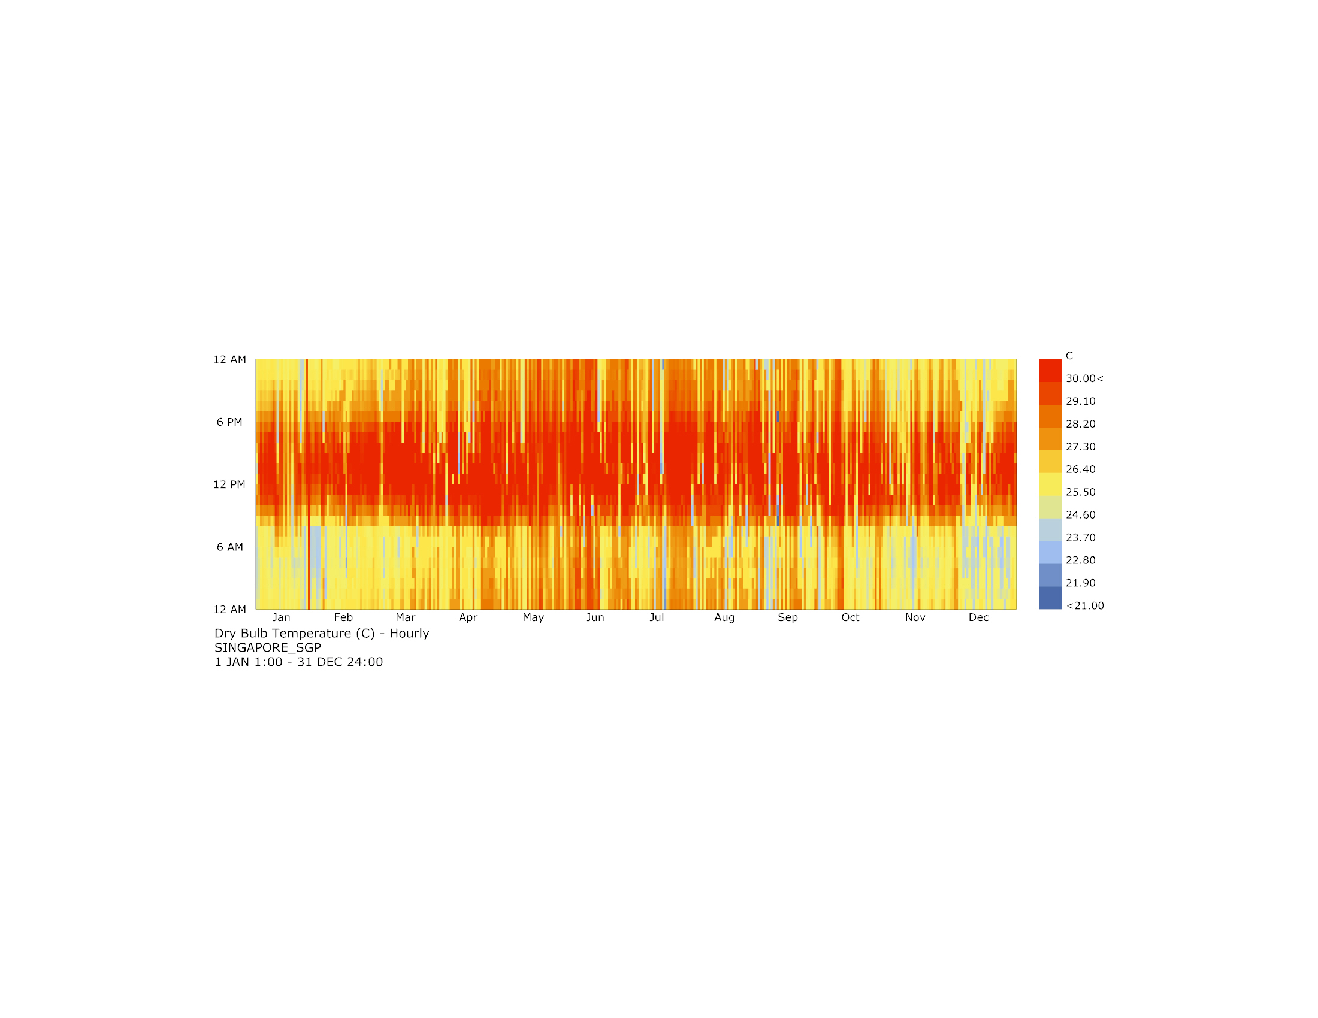
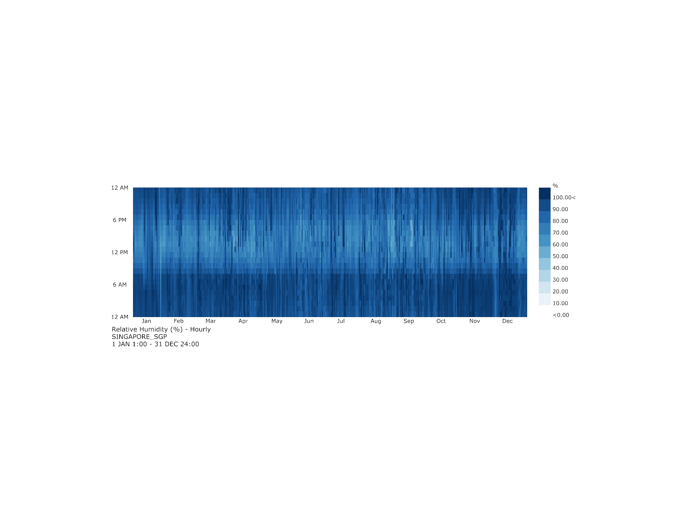
Dry bulb temperature and RH

Slide 47
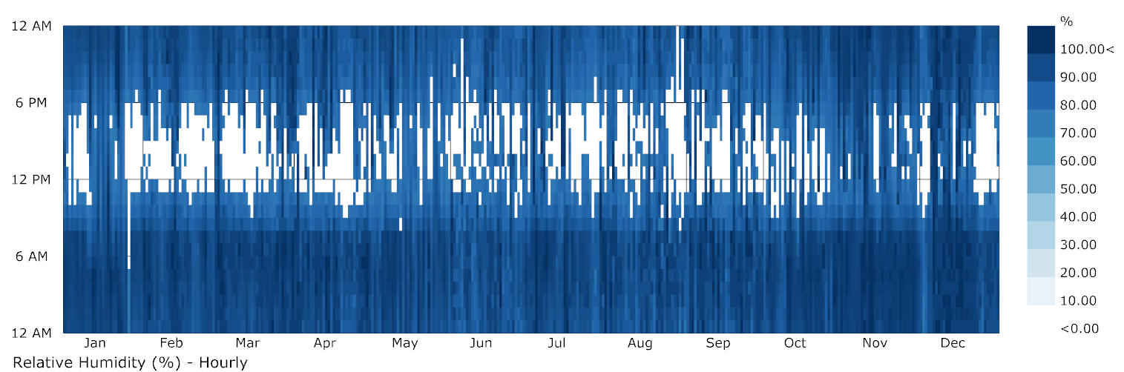
RH – Comfort range
Comfort range between 30% < RH < 70%
There is no RH below 30%.
Number of hours above 70%: 7509 hours, which is equivalent to 85.7% of hours of the year

Slide 48
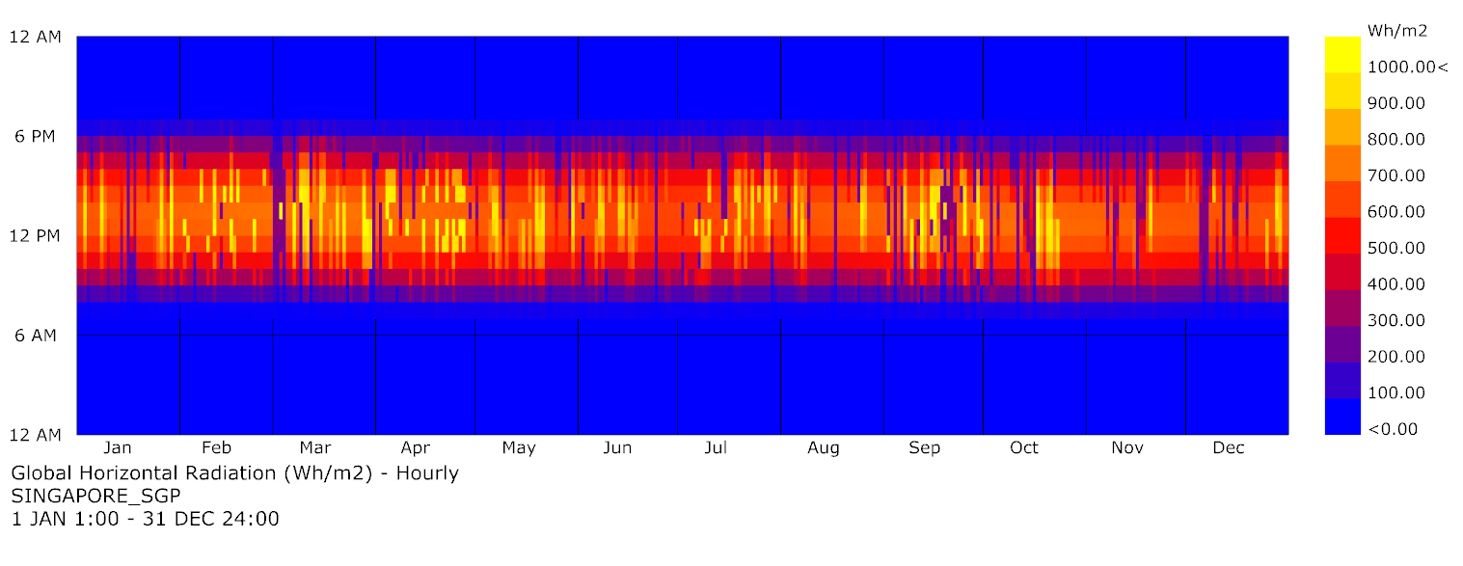
Global Horizontal Radiation

Slide 49

Psychrometric Chart – PMV
Comfort hours without any strategy: 16.2%
Wind speed very low: 0.05 m/s – characteristic of most indoor conditions
Singapore
Met | 1
Clo | 0.7
Wind speed | 0.05 m/s

Slide 50

Psychrometric Chart – Working hours
Comfort hours on PMV method with wind speed 0.05 m/s in between 8:00 to 18:00:
7.2%
PMV
Met | 1
Clo | 0.7
Wind speed | 0.05 m/s

Slide 51
Solar radiation |PVGIS-Sarah x LB
Variation per month*:
Max Δ 43 kWh/m2
Min Δ -26 kWh/m2
*in between measured data and Ladybug output, considering years from 2005 to 2016

Slide 52
Angles study | Vertical angle | 1° step
Overall better 40° again

Slide 53
Solar radiation |Hourly E-S facade
Direct on December
Cloudy morning
Should be roughly the same
Diffuse on June
Cloudy morning
Diffuse during afternoon
Should be roughly the same
Notes:
Check solar radiation here.

Slide 54
Solar radiation |LB
Around the day 265 (22.09) there is a really low average which reflects on the results of the hourly solar radiation

Slide 55
Geometry parameters
Vertical angle
PV Height
Slab thickness
PV Depth
Glass height
Floor to floor height

